Slide 1
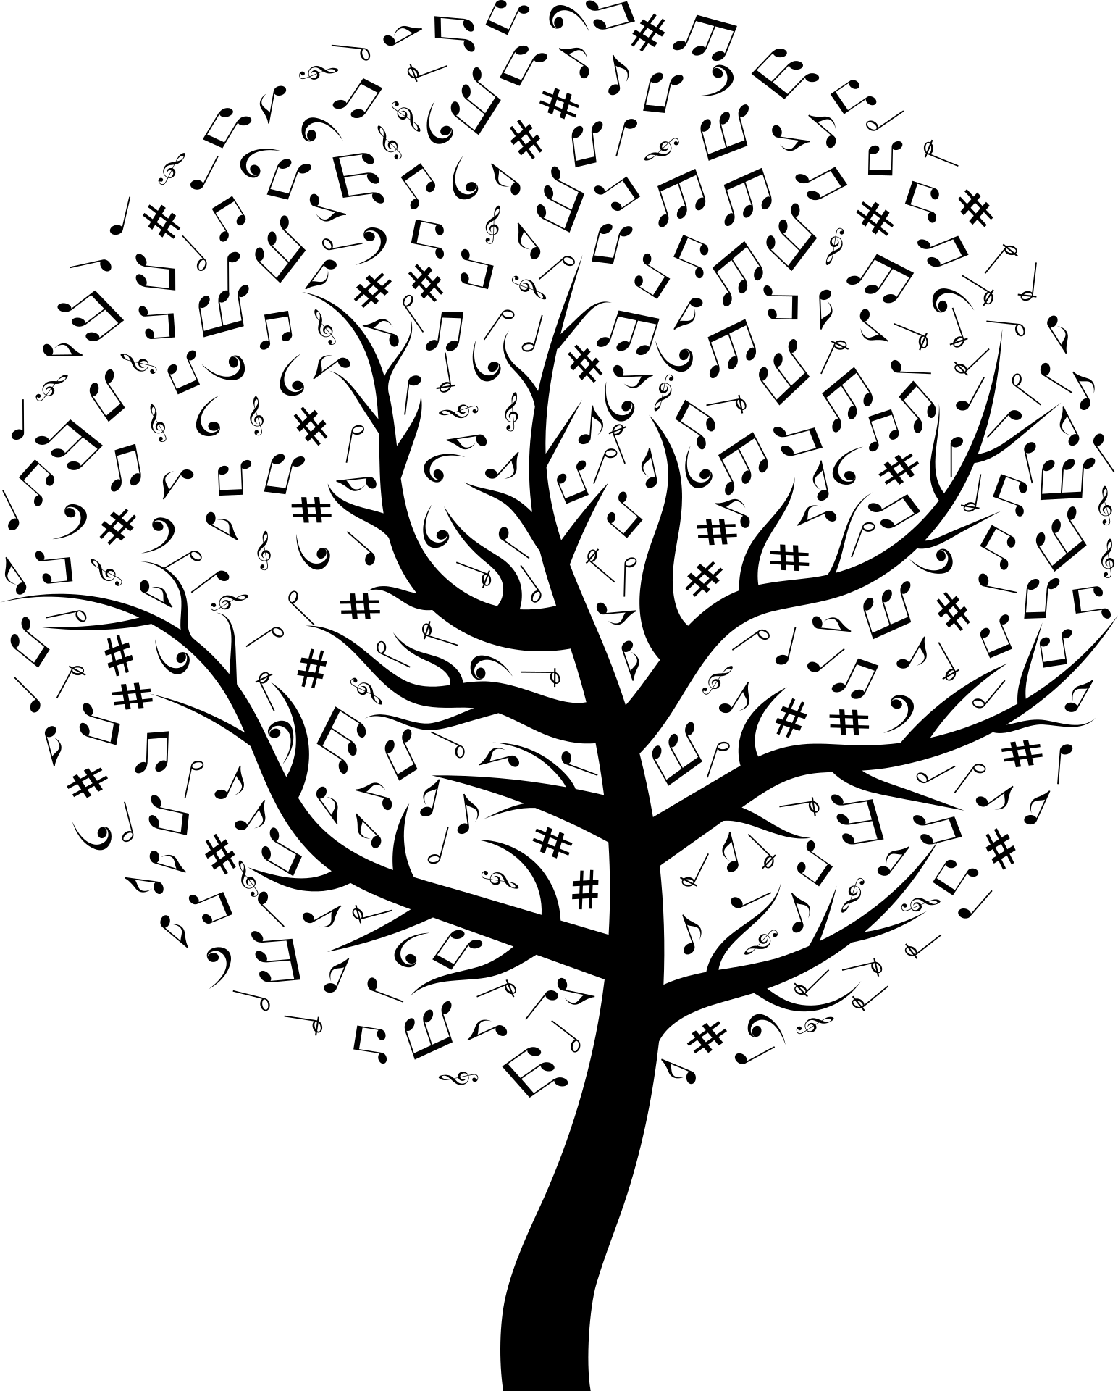
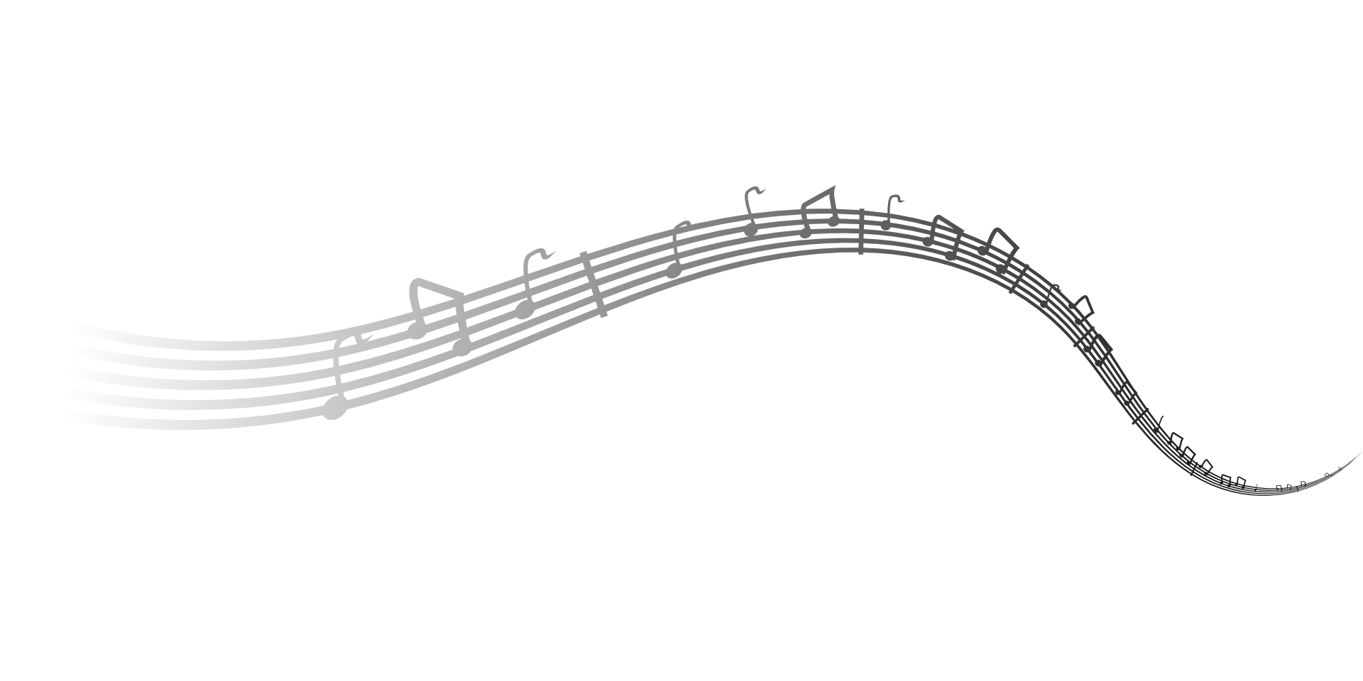
Deep content-based Music Recommendation
Kinan Halloum

Slide 2
Presented paper
Deep content-based music recommendation by van den Oord et al. NIPS 2013

Slide 3
Outline
Music Recommendation
Collaborative filtering
Weighted Matrix Factorization
Content-based Music Recommendation
Neural Networks – Crash course
The cold start problem
Results

Slide 4
Music Recommendation
Basic idea: Suggest music tracks to users
Non content-based
Derive likability from user behavior: Collaborative Filtering
Content-based
Audio meta data, e.g. Year, Artist, Album, Tags etc.
Raw audio data
Hybrid

Slide 5
Usage feedback
Two types of possible feedback
Explicit user track rating
Implicit, e.g. play count, user playlists

Slide 6
Collaborative Filtering
A widely used method for recommending e.g. music, videos etc.
Mainly based on item implicit feedback (play/view count)
Two branches:
Neighborhood based
Model based

Slide 7
Collaborative Filtering
Neighborhood based
A
B
Notes:
Does not necessarily consider play count

Slide 8
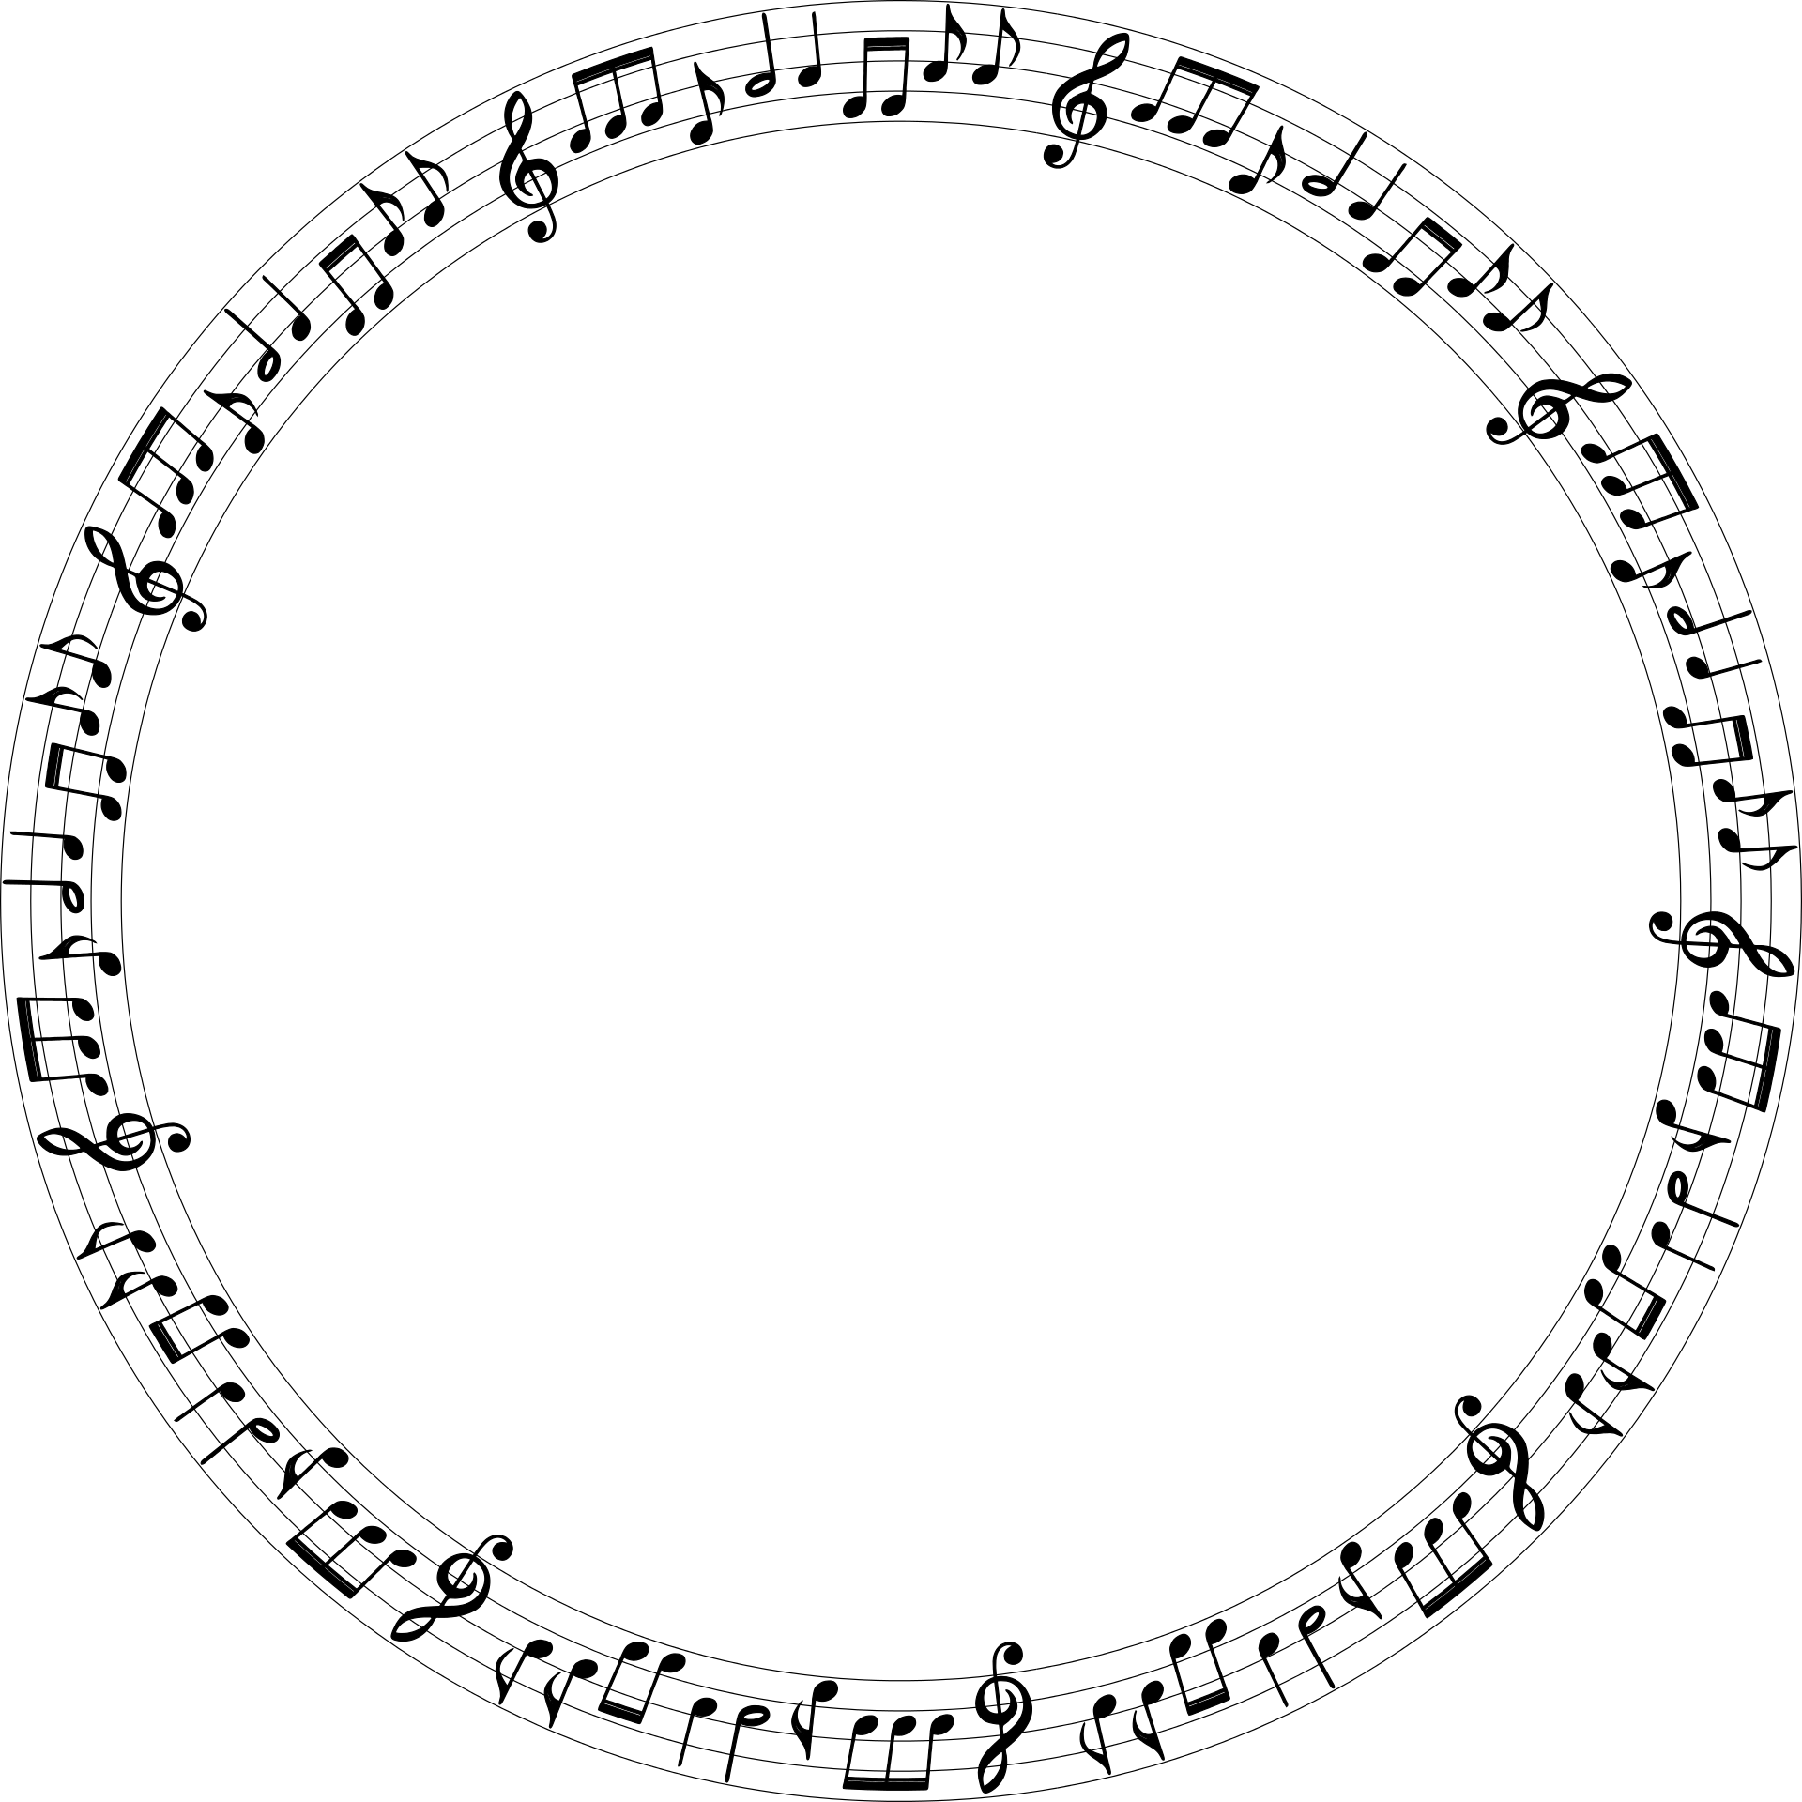
Collaborative Filtering
Model based
$$\left[\begin{aligned}a \\ b \\ c \\ d \\ e\end{aligned}\right]$$
$$\left[\begin{aligned}k \\ l \\ m \\ n \\ o\end{aligned}\right]$$
$U^{T}∙I$
$$U$$
$$I$$
Notes:
We will focus on the model based approach, as it is widely used

Slide 9
Collaborative Filtering – Model based
How do we find such a representation?
Find a user and a track latent vectors such that the user-track score $U^{T}∙I$ is large if and only if the user would (potentially) like the track and vice versa
Incorporate play count into initial user-track score calculation
Notes:
Note that for tracks with high play count, the value must be high

Slide 10
Collaborative Filtering – Model based
For each user $u$, track $i,$a replay count $r_{ui}$ and factors $α, ε$ we define:
Given $c_{ui}$ find $U$ and $I$ with $U^{T}∙I \sim c_{ui}$
$$p_{ui}=indicator_function(r_{ui}>0)$$
preference
$$c_{ui}=1+ α∙log(1+ ε^{−1}r_{ui})$$
confidence
Notes:
Explain why 1. ~ (approximates, corresponds) 2. why confidence and not play counts

Slide 11
Collaborative Filtering – Model based
$$U^{T}∙I \sim c_{ui}$$
For one user-track pair, the above equation has too many solutions
Multiple tracks and users are necessary
Collaborative

Slide 12
Weighted Matrix Factorization
$$I_{1}$$
$$⋯$$
$$I_{n}$$
$$U_{1}$$
$$\left[\begin{matrix}c_{11} & ⋯ & c_{1n} \\ ⋮ & ⋱ & ⋮ \\ c_{m1} & ⋯ & c_{mn}\end{matrix}\right]$$
$$\left[\begin{matrix}I_{1} \\ \begin{aligned}⋮ \\ ⋮\end{aligned} \\ I_{n}\end{matrix}\right]$$
$$\sim$$
$$=$$
$$U^{T}∙I$$
$$⋮$$
${\left[\begin{matrix}U_{1} & \begin{matrix}⋯ & U_{m}\end{matrix}\end{matrix}\right]}^{T}∙$
$$U_{m}$$
Can be solved by the WMF optimization algorithm
[2] Collaborative Filtering for Implicit Feedback Datasets by Hu et al. 2008
Notes:
The purpose of the factorization is not to reproduce user-playcount matrix but rather to fill in the gaps.
Negative confidence is possible
Relate to the cold start problem

Slide 13
The WMF objective function
The objective function used for the WMF algorithm:
$\min_{U, I}\sum_{u, i}{c_{ui}{\left(p_{ui}−U_{u}^{T}∙I_{i}\right)}^{2}}+$ Regularization term

Slide 14
Music Recommendation
Collaborative Filtering generally always performs better than current content-based approaches when enough usage data is available [3]
No direct correspondence between the raw audio signal and song characteristics affecting user preference
→ cold start problem
→ semantic gap
Notes:
To better understand the problem and the solution we need some preliminaries

Slide 15
Neural Networks – Crash course
Train the computer to recognize specific patterns/features in data without having to memorize it entirely
We humans do it all the time

Slide 16
Neural Networks
Output layer
$$y$$
Weights
$$a$$
$$b$$
$$c$$
Input layer
$${ x}_{1}$$
$${ x}_{2}$$
$${ x}_{3}$$
$$y=a∙x_{1}+b∙x_{2}+c∙x_{3} ≔f(X)$$
Notes:
….to demonstrate how we could use such a simple network…

Slide 17
Neural Networks
Discrete signal
$$\left(\begin{matrix}x_{1} & x_{2} & x_{3}\end{matrix}\right)$$
Is the sum of signal differences over time equal to zero?
$${(x}_{1} − x_{2}) −(x_{2} −x_{3})=x_{1}−2∙x_{2}+x_{3}$$
$$a=1$$
$$b=−2$$
$$c=1$$
Notes:
We set the parameters by ourselves, where is the teaching?

Slide 18
Neural Networks - Training
We would like the network to learn the parameters by itself
$$\begin{matrix}x_{1} & x_{2} & x_{3}\end{matrix}$$
Objective function
$$a∙x_{1}+b∙x_{2}+c∙x_{3}=0$$
$$\begin{matrix}y_{1} & y_{2} & y_{3}\end{matrix}$$
$$y=f\left(X\right)=0$$
$$a∙y_{1}+b∙y_{2}+c∙y_{3}=0$$
$$\begin{matrix}z_{1} & z_{2} & z_{3}\end{matrix}$$
$$a∙z_{1}+z∙x_{2}+z∙x_{3}=0$$
Notes:
In this case, the objective function is not feature specific. The training data, together with the function define which features are to be learned

Slide 19
Neural Networks - Training
Data usually contains noise → no exact solution
Error minimization techniques necessary
In our case, $y=0$
Sum of squares error function for data points $X_{i}$
$$\sum_{i}{{\left(f\left(X_{i}\right)−y\right)}^{2}}$$
Minimize gradient
Notes:
Differentiate between y and f(X)
Minimization not only for noise, but also for solving more complex network structures

Slide 20
Deep Neural Networks
Output layer
$$y_{1}$$
$$y_{2}$$
$$h_{1}=g(w_{11}^{1}∙x_{1}+w_{12}^{1}∙x_{2}+w_{13}^{1}∙x_{3})$$
Weights
$$w_{11}^{2}$$
$$w_{23}^{2}$$
Activation function $g$ allows for more complex differentiation and is the same for all nodes in a layer
One popular activation function is the ReLU function: $g\left(x\right)=max⁡(0, x)$
$g$ introduces non-linearities, training only through iterative approaches
Hidden layer
$${ h}_{1}$$
$${ h}_{2}$$
$${ h}_{3}$$
Weights
$$w_{11}^{1}$$
$$w_{33}^{1}$$
Input layer
$${ x}_{1}$$
$${ x}_{2}$$
$${ x}_{3}$$
Notes:
This is an example of a fully connected neural network
Why is it called hidden
Each node in the above layer is connected to all of the one below and each connection has a unique weights

Slide 21
Convolutional Neural Networks (CNNs)
Output layer
$$y_{1}$$
$$y_{2}$$
Nodes in a convolutional layer are only connected to a subset of the nodes in the layer below
Weights are shared across the layer
Computations are much more efficient
Assumption: local features
Adequate for images, audio files etc.
Weights
$$w_{1}^{2}$$
$$w_{2}^{2}$$
$$w_{1}^{2}$$
$$w_{2}^{2}$$
Convolutional
(hidden) layer
$${ h}_{1}$$
$${ h}_{2}$$
$${ h}_{3}$$
Weights
$$w_{1}^{1}$$
$$w_{2}^{1}$$
$$w_{1}^{1}$$
$$w_{2}^{1}$$
Input layer
$${ x}_{1}$$
$${ x}_{2}$$
$${ x}_{3}$$
Notes:
It can be convolutional and not deep and vice versa
Audio signal is often too long -> convolution helps
Trying to capture a characteristic between first and last second of the audio won’t work

Slide 22
The cold start problem
Approach by van den Oord et al. :
Calculate track (and user) latent vectors using the WMF algorithm
${\left[\begin{matrix}I_{1} & \begin{matrix}⋯ & I_{m}\end{matrix}\end{matrix}\right]}^{T}$

Slide 23
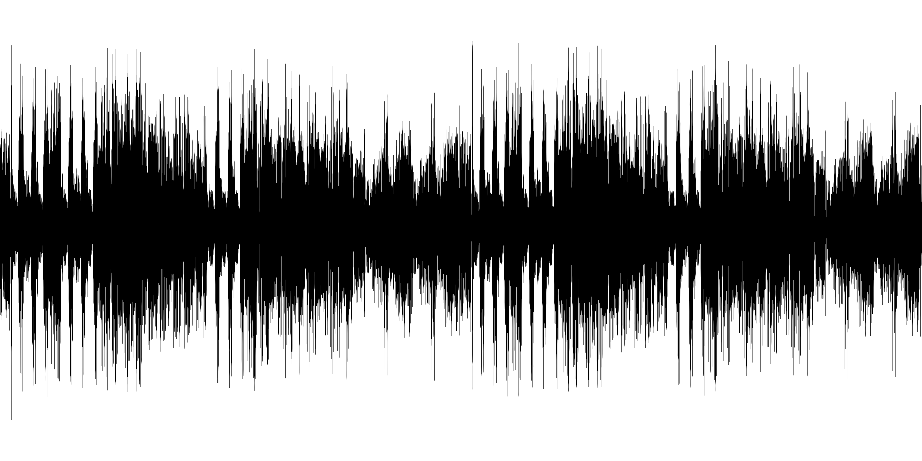
The cold start problem
Best-result approach by van den Oord et al. :
Use the track latent vectors to train a CNN on the corresponding audio data
$$I_{1}$$
…
$$I_{m}$$
CNN
Notes:
Note that raw audio data is not directly used

Slide 24
The cold start problem
Best-result approach by van den Oord et al. :
Use the trained network to predict latent vectors for tracks with little respectively no usage data

Slide 25
Results - Quantitative
Training dataset: 1 million users and 382,410 tracks
Model | Mean Average Precision
Random | 0.00015
CNN with Mean Square Error | 0.00672
CNN with WMF objective function | 0.23278

Slide 26
Results - Qualitative
Query
Most similar tracks (WMF)
Most similar tracks (CNN)
Coldplay - I Ran Away
Coldplay – Careful Where You Stand
Arcade Fire - Keep The Car Running
Coldplay - The Goldrush
M83 - You Appearing
Coldplay - X & Y
Angus & Julia Stone - Hollywood

Slide 27
Own implementation
Placeholder slide

Slide 28
Results
Placeholder slide

Slide 29
References
van den Oord et al. Deep content-based music recommendation NIPS, 2013
Y. Hu et al. Collaborative filtering for implicit feedback datasets. IEEE International Conference on Data Mining, 2008
M. Slaney. Web-scale multimedia analysis: Does content matter? MultiMedia, IEEE, 18(2):12–15, 2011

Slide 30
Thank you for your attention!

