Slide 1
Computation of Mutual Information Metric for Image Registration on Multiple GPUs
Andrew V. Adinetz¹, Markus Axer², Marcel Huysegoms², Stefan Köhnen², Jiri Kraus³, Dirk Pleiter¹
¹ JSC, Forschungszentrum Jülich
² INM-1, Forschungszentrum Jülich
³ NVIDIA GmbH
26.08.2013

Slide 2
Outline
Brain Image Registration
Multi-GPU Implementation
system memory
listupdate
Performance Evaluation
Conclusion

Slide 3
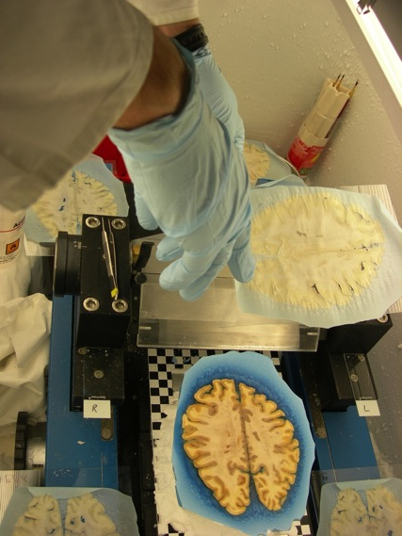
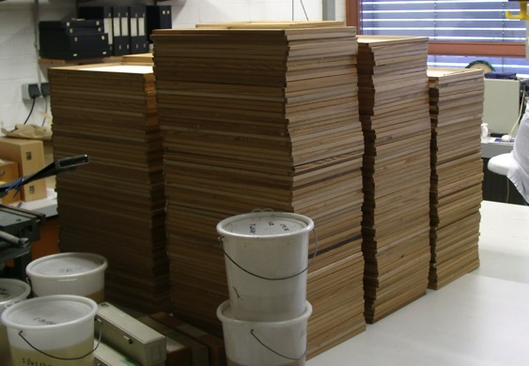
Preparation of the brain

Slide 4
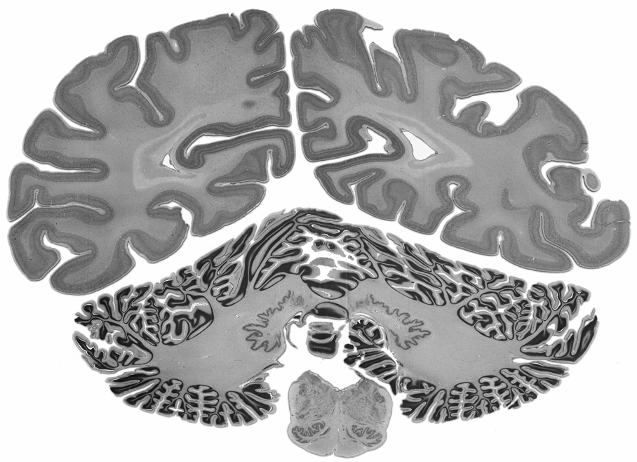
Pushing the limits for a cellular brain model
BigBrain – first high-resolution brain model at microscopical scale
7404 histological sections stained for cell bodies
scanned with a flad bed scanner
original resolution 10 × 10 × 20 μm³ (11.000 × 13.000 pixels)
downscaling to 20 μm isotropic
removal of artifacts
1 Terabyte
in cooperation with Alan Evans, McGill, Montreal
Amunts et al. (2013) Science
Notes:
6 years

Slide 6
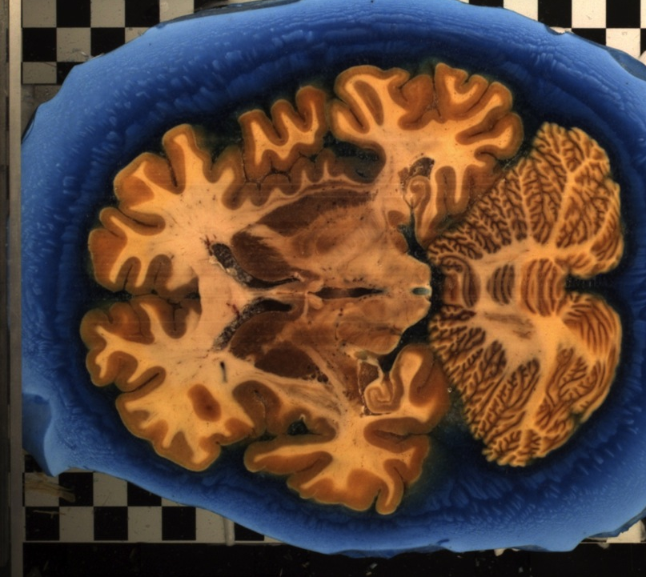

Slide 7
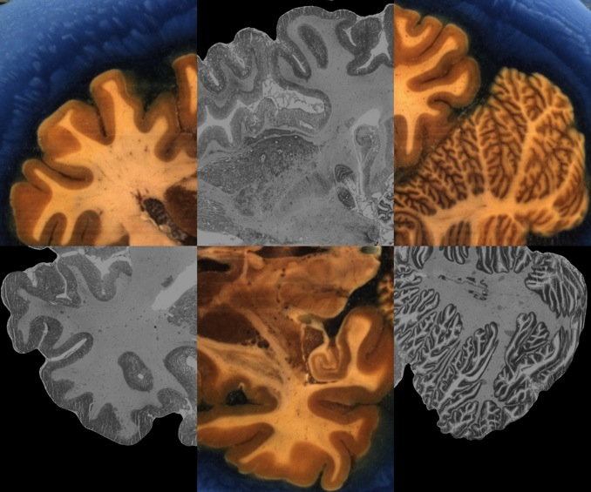

Slide 8
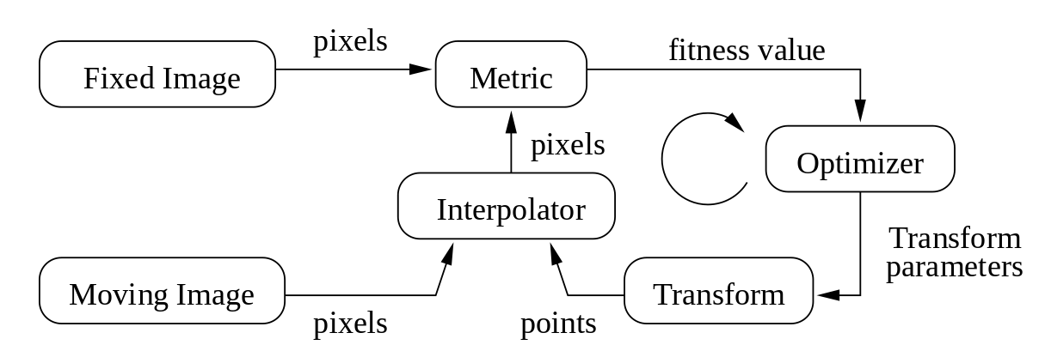
Image Registration
The process of aligning images is called registration
ITK Workflow

Slide 9
Mutual Information Metric
i, j – pixel values (0 .. 255)
successful for multi-modal registration

Slide 10
Two Image Cross-Histogram
for(int y = 0; y < fixed_sz_y; y++)
for(int x = 0; x < fixed_sz_x; x++) {
int i = bin(fixed[x, y]);
float x1 = transform_x(x, y);
float y1 = transform_y(x, y);
int j = bin(interpolate(moving, x1, y1));
histogram[i, j]++; // atomic on GPU
}
main computational kernel
transform can be complex (1000+ parameters)
GPU implementation: 1 pixel/thread, atomics

Slide 11
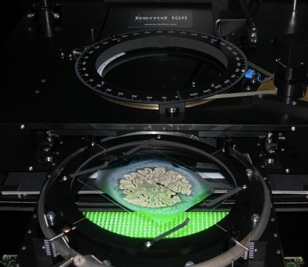
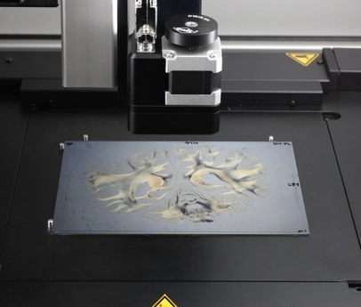
Large Data Size
Large-area Polarimeter
Polarizing Microscope
size: 3.000 × 3.000 px
pixel size: 60 × 60 μm
file size: 30 MB
size: 100.000 × 100.000 px
pixel size: 1.6 x 1.6 μm
file size: 40 GB

Slide 12
Multi-GPU Mutual Information
Domain decomposition
distribute fixed and moving images
histogram contributions summed up
Moving image: how to handle?
irregular access pattern
Approaches
System memory replication (sysmem)
Listupdate (listupdate)

Slide 13
System Memory Replication
Replicate entire moving image in pinned host RAM
accessible to GPU
+ easy to implement
– system memory accesses are slower
– cannot use texture interpolation
Optimizations
moving image halo in GPU RAM

Slide 14
Listupdate
typedef struct {
float[2] movingCoords;
short destRank;
char fixedBin;
} message_t;
Processing
buffer remote accesses
exchange buffers
compute contributions remotely
+ computation-communication overlap
– hard to implement
– chunk processing (or won‘t fit into buffer)
Optimizations
buffers: AoS vs. SoA, atomics vs. grouping
using multiple streams

Slide 15
Chunk Processing and Overlap
y
Fixed Image
Fixed Image
(0,0)
x
1
Process chunk
Group
Exchange
Handle messages
Process chunk
Group
2
Process chunk
Group
Exchange

Slide 16
Buffer Writeout: Atomics vs. Group
atomics
each writing thread increments atomic counter
+ simpler
– atomics can be a bottleneck
– one buffer per receiver required
grouping
each thread writes to fixed location
buffers grouped before sending
+ single buffer, less memory
+ optimized grouping (shared-memory atomics, prefix sum)
– more complicated (separate kernel required)

Slide 17
Benchmark setup
Moving Image
Remote access
y
Fixed Image
Fixed Image
Mask
(0,0)
x

Slide 18
Test Hardware
JUDGE
256-node GPU cluster
Each M2070 node:
2x M2070 (Fermi) GPU, each 6 GB RAM
12-core X5650 CPU @ 2.67 GHz, 96 GB RAM
JuHydra
single-node Kepler machine
2x K20X (Kepler) GPU, each 6 GB RAM
16-core E5-2650 CPU @ 2 GHz, 64 GB RAM

Slide 19
Baseline: Full Replication (M2070)
ideal scalability

Slide 20
Sysmem on Fermi

Slide 21
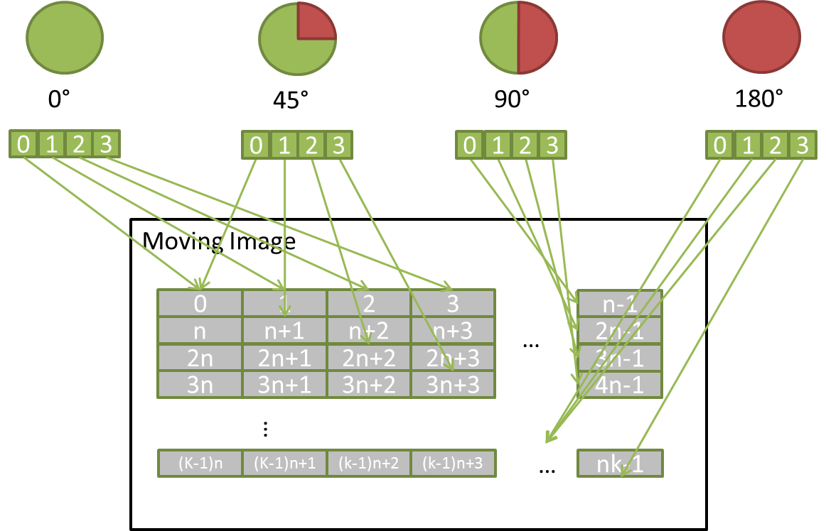
Sysmem on Fermi: Explanation
No sysmem Access
Good Coalescing
Few sysmem Access
Bad Coalescing
Many sysmem Access
Bad Coalescing
Most sysmem Access
Good Coalescing

Slide 22
Sysmem on Fermi: PCI-E Queries

Slide 23
Sysmem: Halo Sizes
mostly quantitative, not qualitative difference

Slide 24
Listupdate: Multiple Streams
4 streams look the best

Slide 25
Listupdate: AoS vs SoA, Atomics vs Group
SoA + atomics looks best

Slide 26
Sysmem vs. Listupdate: Fermi
on Fermi, sysmem is better

Slide 27
Sysmem vs. Listupdate: Kepler (Closeup)
on Kepler, listupdate is better

Slide 28
Conclusions
Fermi
performance limited by atomics
system memory replication is better
Kepler
order of magnitude faster than Fermi
no longer dominated by atomics
listupdate (atomic, SoA, 4 streams) is better
Future work
Compression
Trials on real images

Slide 29
Questions
?
INM-1 at FZJ: http://www.fz-juelich.de/inm/inm-1/EN/Home/home_node.html
NVidia Application Lab at FZJ: http://www.fz-juelich.de/ias/jsc/nvlab
Andrew V. Adinetz: adinetz@gmail.com
Jiri Kraus: jkraus@nvidia.com
Dirk Pleiter: d.pleiter@fz-juelich.de

