Slide 1
Paralldroid
Towards a unified heterogeneous development
model in Android™
Alejandro Acosta
aacostad@ull.es
Francisco Almeida
falmeida@ull.es
High Performance Computing Group
Notes:
I will talk about paralldroid
A source to source translator to simplify the use of efficient code in Android.
This work has been developed as a research line of the High Performance Computing Group at La Laguna University

Slide 2
Introduction
Heterogeneity in Android
Hardware level.
Programing model level.
Developing heterogeneous code is a difficult task.
Expert programmer.
Standards (based in compiler directives) designed to simplify parallel programming.
OpenMP: Shared memory systems.
OpenACC: Accelerator systems.
This idea could be applied to the Android programming models.
Notes:
In android we have two different levels of heterogeneity, at the hardware level (GPU and multi-CPU ) and at the set of languages that allow to the developer programming these resources.
The development of heterogeneous code is a complex task and require an expert programmer.
In the scientific context, we have a set of tools that simplify development of heterogeneous code.
Like the new version of OpenMP or OpenACC that allow the generation of code for heterogeneous systems.
This idea could be applied to the Android programming models.

Slide 3
Android Programming Models
Java (Dalvik)
Native C
Renderscript
OpenCL
Gray scale
Android Open Source project AOSP (frameworks/base/tests/RenderScriptTests/ImageProcessing)
Notes:
I`m going to do a quick introduction to the Android programming models.
As an example I`m going to use a simple problem, to transform a image to grayscale.

Slide 4
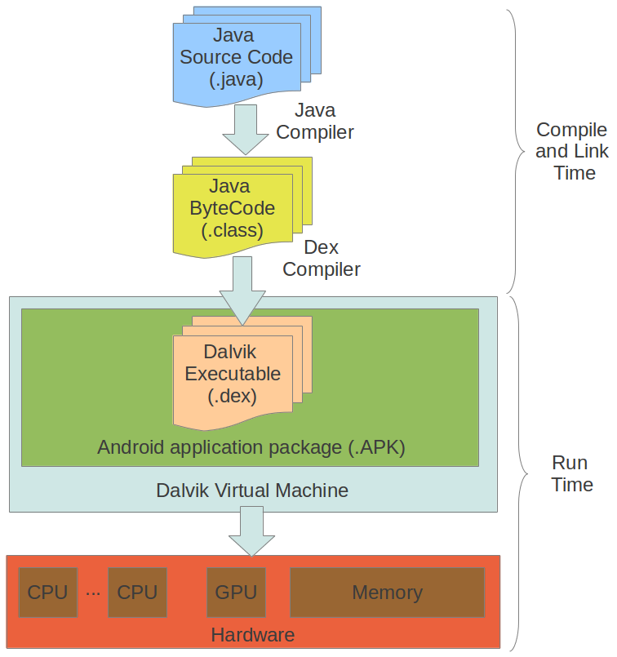
Android Programming Models
Java (Dalvik)
Commonly used
Simple
public void Grayscale() {
int r, g, b, a;
Color color, gray;
for (int x = 0; x < width; x++) {
for (int y = 0; y < height; y++) {
Color color = bitmapIn.get(x, y);
r = color.getRed() * 0.299f;
g = color.getGreen() * 0.587f;
b = color.getBlue() * 0.114f;
gray = new Color(r, g, b, color.getAlpha());
bitmapOut.set(x, y, gray);
}
}
}
Notes:
The most used programming model is based in Java, Java Code is compiled using the Java compiler and the bytecode obtained is compiled using a dex compiler.
Java is well know and easy to understand.
As you can see in this example.
We have a loop, gets each pixels of the image, gets color and changes to greyscale.

Slide 5
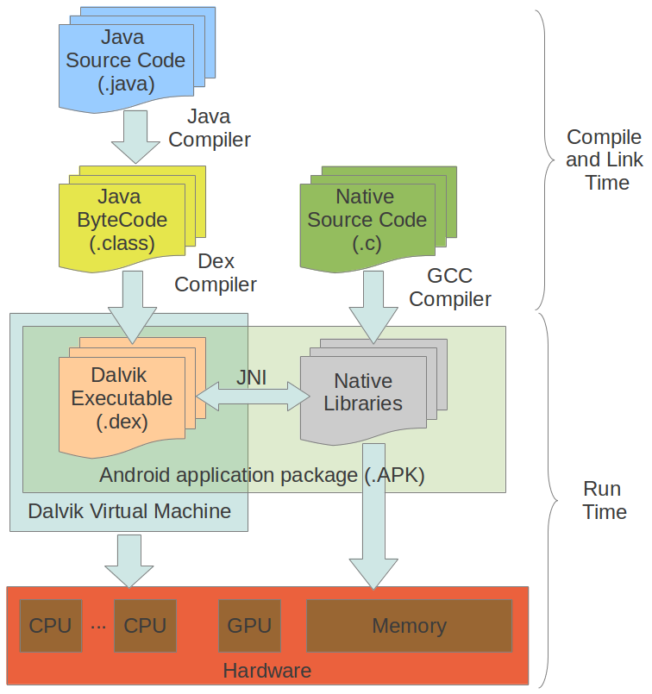
Android Programming Models
Native C
C library compatibility
Complex
public void Grayscale() {
try {
System.loadLibrary("grayscale");
}
catch ….
nativeGrayscale(bitmapIn, bitmapOut);
}
public native void nativeGrayscale(Bitmap
bitmapin, Bitmap bitmapout);
Notes:
Another programming model is the native C, in this case some sections of the applications can be implemented using a native C language.
This model is often used to reuse existing code libraries written in native languages
This native code is compiled using a native compiler.
The complexity of this model is high,
the implementations are divided of two parts,
A Java Section, where we load the compiled native code, and the definition and call of the native function.

Slide 6
Android Programming Models
void Java_….._nativeGrayscale (…, jobject bitmapIn, jobject bitmapOut) {
AndroidBitmapInfo info;
uint32_t * pixelsIn, pixelsOut;
AndroidBitmap_lockPixels(env, bitmapIn, (void **)(&pixelsIn));
AndroidBitmap_lockPixels(env, bitmapOut, (void **)(&pixelsOut));
AndroidBitmap_getInfo(env, bitmapIn, &info);
uint32_t width = info.width, height = info.height;
int x, pixel, sum;
for(x = 0; x < width*height; x++) {
pixel = pixelsIn[x];
sum = (int)(((pixel) & 0xff) * 0.299f);
sum += (int)(((pixel >> 8 ) & 0xff) * 0.587f);
sum += (int)(((pixel >> 16) & 0xff) * 0.114f);
pixelsOut[x] = sum + (sum << 8) + (sum << 16) + (pixelsIn[x] & 0xff000000);
}
AndroidBitmap_unlockPixels(env, bitmapIn);
AndroidBitmap_unlockPixels(env, bitmapOut);
}
Notes:
And the implementation of native funtions.

Slide 7
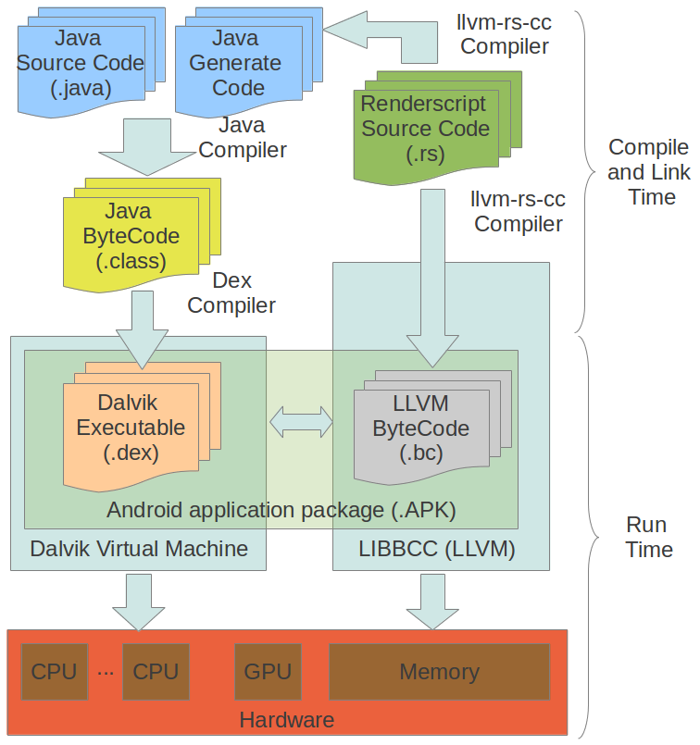
Android Programming Models
Renderscript
High Performance
Limited
public void Grayscale() {
RenderScript mRS;
ScriptC_grayscale mScript;
Allocation mInAlloc;
Allocation mOutAlloc;
mRS = RenderScript.create(act);
mScript = new ScriptC_grayscale(mRS,….);
mInAlloc = Allocation.createFromBitmap(...);
mOutAlloc=Allocation.createFromBitmap(…);
mScript.forEach_root(mInAlloc,mOutAlloc);
mOutAlloc.copyTo(bitmapOut);
}
Notes:
The next model we consider is Renderscript.
This model is designed to accelerate some sections of the code.
When Renderscript code is compiled two codes are generated. Bytecode for a low level virtual machine. And Java code access to elements defined in renderscript.
Renderscript simplifies the implementation of efficient code but the problem is that renderscript is a new language and has a new parallel model. the programmer has to learn how it works.
The implementation is divided in two sections
A Java Section, where we create Renderscript context
Allocate memory
And call to the renderscript function.

Slide 8
Android Programming Models
Renderscript
#pragma version(1)
#pragma rs java_package_name(…)
const static float3 gMonoMult = {0.299f, 0.587f, 0.114f};
void root(const uchar4 *v_in, uchar4 *v_out) {
float4 f4 = rsUnpackColor8888(*v_in);
float3 mono = dot(f4.rgb, gMonoMult);
*v_out = rsPackColorTo8888(mono);
}
Notes:
The RenderScript code is similar to C, but with some extensions as vector operations.

Slide 9
Android Programming Models
OpenCL
High performance
Complex
public void Grayscale() {
try {
System.load("/system/vendor/lib/egl/libGLES_mali.so");
System.loadLibrary("grayscale");
}
catch ….
openclGrayscale(bitmapIn, bitmapOut);
}
public native void openclGrayscale(Bitmap bitmapin, Bitmap bitmapout);
Notes:
OpenCL is also designed to accelerate some sections of the application.
The Java implementation is similar to that presented for the native model. The only difference is the load the OpenCL libraries.

Slide 10
Android Programming Models
OpenCL
void Java_….._openclGrayscale (…, jobject bitmapIn, jobject bitmapOut) {
// get data from Java
// create OpenCL context
// allocate OpenCL data
// copy data from host to OpenCL
// create kernel
// load parameter
// execute kernel
// copy data from OpenCL to host
// set data to Java
}
OpenCL Boilerplate code
Notes:
The implementation of native funtion with OpenCL code.

Slide 11
Paralldroid
Source to Source translator based on directives.
Use Java.
Extension of OpenMP 4.0
Eclipse plugin.
// pragma paralldroid target lang(rs) map(to:scrPxs,width,height) map(from:outPxs)
// pragma paralldroid parallel for private(x,pixel,sum) rsvector(scrPxs,outPxs)
for(x = 0; x < width*height; x++) {
pixel = scrPxs[x];
sum = (int)(((pixel) & 0xff) * 0.299f);
sum += (int)(((pixel >> 8 ) & 0xff) * 0.587f);
sum += (int)(((pixel >> 16) & 0xff) * 0.114f);
outPxs[x] = (sum) + (sum << 8) + (sum << 16) + (scrPxs[x] & 0xff000000);
}
Notes:
Ideally, programmers implement their applications using a simple language, java in this case, but we want efficient code like renderScript or OpenCL.
So, we developed paralldroid a source to source translator that generate efficient code from annotated Java code.
The set of directives used is an extension of OpenMP 4.0.
This is an example of a Java implementation for greyscale.

Slide 12
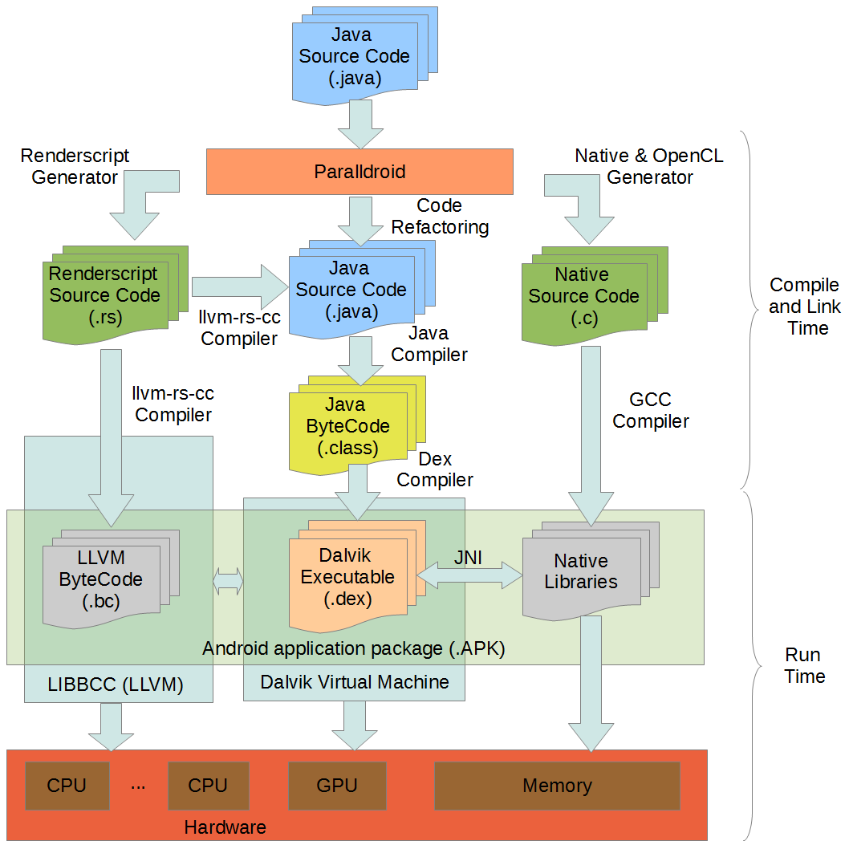
Paralldroid
Notes:
The Paralldroid generation process is in the top level, is responsible to analyzing the java code looking for directives.

Slide 13
Paralldroid
Notes:
The files that don’t contain directives are compiled directly.

Slide 14
Paralldroid
Notes:
If paralldroid finds a directive for native or OpenCL code generation, this code is generated and the Java code is modified to access to generated native code.

Slide 15
Paralldroid
Notes:
The same process is used to generate renderscript code.

Slide 16
Paralldroid
Directives
Target data
Target
Parallel for
Teams
Distribute
Notes:
This is the set of directives supported in paralldroid

Slide 17
Paralldroid
Directives
Clauses
Target data
Target
Parallel for
Teams
Distribute
Lang(rs | native | opencl)
Map(map-type: list)
Map-type
Alloc
To
From
Tofrom
Target
Lang
Java
Map alloc
Map to / tofrom
Map from / tofrom
Target
Data
Notes:
Target Data is responsible of mapping the data to the context of the accelerator.
The Lang clause is an extension to the OpenMP standard, and indicates the target language that we want generate. RenderScript, native or OpenCL
Map clauses indicate the data that must be mapped to the accelerator.

Slide 18
Paralldroid
Directives
Clauses
Target data
Target
Parallel for
Teams
Distribute
Lang(rs | native | opencl)
Map(map-type: list)
Map-type
Alloc
To
From
Tofrom
Java
Target
Lang
Map alloc
Map to / tofrom
Map from / tofrom
Target
Notes:
The target directive is responsible of mapping the data and execute the code associated to the directive in the accelerator.
The clauses have the same function as in the previous case.

Slide 19
Paralldroid
Directives
Clauses
Target data
Target
Parallel for
Teams
Distribute
Private(list)
Firstprivate(list)
Shared(list)
Colapse(n)
Rsvector(var,var)
Use inside of target directives
For Loop
Notes:
The parallel for directive should be used in the context of a target directive,
this directive is responsible of distributing the load of the for loop between the threads available on the accelerator.
private clause indicates that each thread has a private copy of the variables.
firstprivate clause is the same but the variables are initialized.
Shared indicates that all threads shared the variables.
Colapse is used for nested loops, the load of all nested loop is distributed between available threads.
Rsvector is an OpenMP extension. it is used for renderscript code generation and indicates the input and output vectors used in the parallel function call of renderScript.

Slide 20
Paralldroid
Directives
Clauses
Target data
Target
Parallel for
Teams
Distribute
Num_teams(exp)
Num_thread(exp)
Private(list)
Firstprivate(list)
Shared(list)
Use inside of target directives
Notes:
The teams should be used in the context of a target directive, this directive is responsible of teams or group of threads.
Num_teams indicates the number of teams
Num_thread indicates the number of threads of each threads.
private clause indicates that each teams have a private copy of the variables. These variables are shared between all threads in a teams.
firstprivate clause is the same but the variables are initialized.
Shared indicates that all teams shared the variables.

Slide 21
Paralldroid
Directives
Clauses
Target data
Target
Parallel for
Teams
Distribute
Private(list)
Firstprivate(list)
Colapse(constant)
Use inside of teams directives
For Loop
Notes:
Distribute directive should be used in the context of a target directive, this directive is similar to the parallel for directive but in this case distributes the load of the for loop between the teams available on the accelerator.
Clauses are similar to the parallel for case.

Slide 22
Paralldroid
public void grayscale() {
int pixel, sum, x;
int [] scrPxs = new int[width*height];
int [] outPxs = new int[width*height];
bitmapIn.getPixels(scrPxs, 0, width, 0, 0, width, height);
for(x = 0; x < width*height; x++) {
pixel = scrPxs[x];
sum = (int)(((pixel) & 0xff) * 0.299f);
sum += (int)(((pixel >> 8 ) & 0xff) * 0.587f);
sum += (int)(((pixel >> 16) & 0xff) * 0.114f);
outPxs[x] = (sum) + (sum << 8) + (sum << 16) + (scrPxs[x] & 0xff000000);
}
bitmapOut.setPixels(outPxs, 0, width, 0, 0, width, height);
}
Notes:
it is an example of how to use the directives.
This is the Java implementation of greyscale problems.

Slide 23
Paralldroid
public void grayscale() {
int pixel, sum, x;
int [] scrPxs = new int[width*height];
int [] outPxs = new int[width*height];
bitmapIn.getPixels(scrPxs, 0, width, 0, 0, width, height);
for(x = 0; x < width*height; x++) {
pixel = scrPxs[x];
sum = (int)(((pixel) & 0xff) * 0.299f);
sum += (int)(((pixel >> 8 ) & 0xff) * 0.587f);
sum += (int)(((pixel >> 16) & 0xff) * 0.114f);
outPxs[x] = (sum) + (sum << 8) + (sum << 16) + (scrPxs[x] & 0xff000000);
}
bitmapOut.setPixels(outPxs, 0, width, 0, 0, width, height);
}
Notes:
Currently, the translator doesn’t work with objects, so we transform the bitmap into an array of pixels.

Slide 24
Paralldroid
public void grayscale() {
int pixel, sum, x;
int [] scrPxs = new int[width*height];
int [] outPxs = new int[width*height];
bitmapIn.getPixels(scrPxs, 0, width, 0, 0, width, height);
for(x = 0; x < width*height; x++) {
pixel = scrPxs[x];
sum = (int)(((pixel) & 0xff) * 0.299f);
sum += (int)(((pixel >> 8 ) & 0xff) * 0.587f);
sum += (int)(((pixel >> 16) & 0xff) * 0.114f);
outPxs[x] = (sum) + (sum << 8) + (sum << 16) + (scrPxs[x] & 0xff000000);
}
bitmapOut.setPixels(outPxs, 0, width, 0, 0, width, height);
}
Notes:
Traverses the array of pixels, gets colors and transform to grayscale

Slide 25
Paralldroid
public void grayscale() {
int pixel, sum, x;
int [] scrPxs = new int[width*height];
int [] outPxs = new int[width*height];
bitmapIn.getPixels(scrPxs, 0, width, 0, 0, width, height);
// pragma paralldroid target lang(rs) map(to:scrPxs,width,height) map(from:outPxs)
// pragma paralldroid parallel for private(x,pixel,sum) rsvector(scrPxs,outPxs)
for(x = 0; x < width*height; x++) {
pixel = scrPxs[x];
sum = (int)(((pixel) & 0xff) * 0.299f);
sum += (int)(((pixel >> 8 ) & 0xff) * 0.587f);
sum += (int)(((pixel >> 16) & 0xff) * 0.114f);
outPxs[x] = (sum) + (sum << 8) + (sum << 16) + (scrPxs[x] & 0xff000000);
}
bitmapOut.setPixels(outPxs, 0, width, 0, 0, width, height);
}
Notes:
Target lang(rs) and mapping the variables
And we add the
Parallel for directive assigning private variables and the input and output vector for renderscript

Slide 26
Paralldroid
public void grayscale() {
int pixel, sum, x;
int [] scrPxs = new int[width*height];
int [] outPxs = new int[width*height];
bitmapIn.getPixels(scrPxs, 0, width, 0, 0, width, height);
// pragma paralldroid target lang(native) map(alloc:x,pixel,sum)
for(x = 0; x < width*height; x++) {
pixel = scrPxs[x];
sum = (int)(((pixel) & 0xff) * 0.299f);
sum += (int)(((pixel >> 8 ) & 0xff) * 0.587f);
sum += (int)(((pixel >> 16) & 0xff) * 0.114f);
outPxs[x] = (sum) + (sum << 8) + (sum << 16) + (scrPxs[x] & 0xff000000);
}
bitmapOut.setPixels(outPxs, 0, width, 0, 0, width, height);
}
Notes:
To generate native code we add a target directive with lang native, in this case we don't want to initialize or return the value of any of these variables, so we use the map alloc.

Slide 27
Paralldroid
public void grayscale() {
int pixel, sum, x;
int [] scrPxs = new int[width*height];
int [] outPxs = new int[width*height];
bitmapIn.getPixels(scrPxs, 0, width, 0, 0, width, height);
// pragma paralldroid target lang(opencl)
// pragma paralldroid teams num_teams(32) num_threads(256)
// pragma paralldroid distribute private(x,pixel,sum) firstprivate(width,height)
for(x = 0; x < width*height; x++) {
pixel = scrPxs[x];
sum = (int)(((pixel) & 0xff) * 0.299f);
sum += (int)(((pixel >> 8 ) & 0xff) * 0.587f);
sum += (int)(((pixel >> 16) & 0xff) * 0.114f);
outPxs[x] = (sum) + (sum << 8) + (sum << 16) + (scrPxs[x] & 0xff000000);
}
bitmapOut.setPixels(outPxs, 0, width, 0, 0, width, height);
}
Notes:
For OpenCL we add a target directive with lang openCL.
We define the teams,
And in this case, the number of teams is the OpenCL work_group and the number of threads is the work_item
And next we distribute the load of the for loop between all teams.

Slide 28
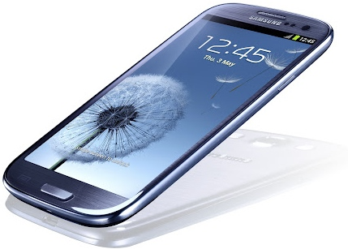
Computational Result
Samsung Galaxy SIII
Exynos 4 (4412)
Quad-core, ARM Cortex-A9 (1.4GHz)
GPU ARM Mali-400/MP4
1 GB RAM memory
Android 4.1
No support OpenCL
Asus Transformer Prime TF201
NVIDIA Tegra 3
Quad-core, ARM Cortex-A9 (1.4GHz, 1.5 GHz in single-core mode)
GPU NVIDIA ULP GeForce.
1GB of RAM memory
Android 4.1
No support OpenCL
Notes:
To prove the performance of paralldroid we used two different devices.

Slide 29
Computational Result
Renderscript ImageProcessing benchmark (AOSP: frameworks/base/tests/RenderScriptTests/ImageProcessing)
Grayscale
Convolve 3x3
Convolve 5x5
Levels
General Convolve
3x3
5x5
7x7
9x9
Ad-hoc Java (Dalvik)
Ad-hoc Native C
Ad-hoc Renderscript
Generated Native C
Generated RenderScript
Generated OpenCL
1600x1067
Notes:
We used a set of problems defined on the renderscript benchmark
Greyscale
Convolve with a kernel of size 3 and 5
And levels
We implemented a general version of convolve
and we used kernel of size 3 5 7 and 9
We have a version of each android programing model for all problems.
Ad-hoc Java
Ad-hoc Native C
Ad-hoc Renderscript
And the versions generated by paralldroid
Generated native
Generated renderscript
And generated OpenCL
OpenCL version can not be executed in these devices.
All test have been done using this image.

Slide 30
AOSP Benchmark problems
Notes:
These charts show speedup relative to the ad-hoc java version for renderscript benchmark probleams.
the native versions don't have differences between ad-hoc version and generated version.
Ad-hoc renderscript version gets the best results, due that this version is optimized and uses vector operations.
Currently the translator doesn't obtain this level of optimization but has a positive speedup.

Slide 31
General convolve
Notes:
For the general convolve problem similar results are observed.

Slide 32
Conclusion
The methodology used has been validated on scientific environments.
We proved that this methodology can be also applied to not scientific environments.
The tool presented makes easier the development of heterogeneous applications in Android.
We get efficient code at a low development cost.
The ad-hoc versions get higher performance but their implementations are more complex.

Slide 33
Future work
Adding new directives and clauses.
To generate parallel native C code.
To generate parallel Java code.
Working with objects.
To generate vector operations.

Slide 34
Thanks
Alejandro Acosta
aacostad@ull.es
Francisco Almeida
falmeida@ull.es
High Performance Computing Group
FEDER-TIN2011-24598

