Slide 1
High-performance Implementations of Fast Matrix Multiplication with Strassen’s Algorithm
STRASSEN
Jianyu Huang
with Tyler M. Smith, Greg M. Henry, Robert A. van de Geijn

Slide 2
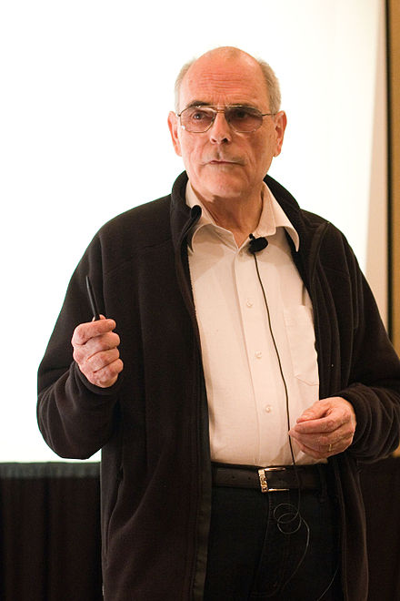
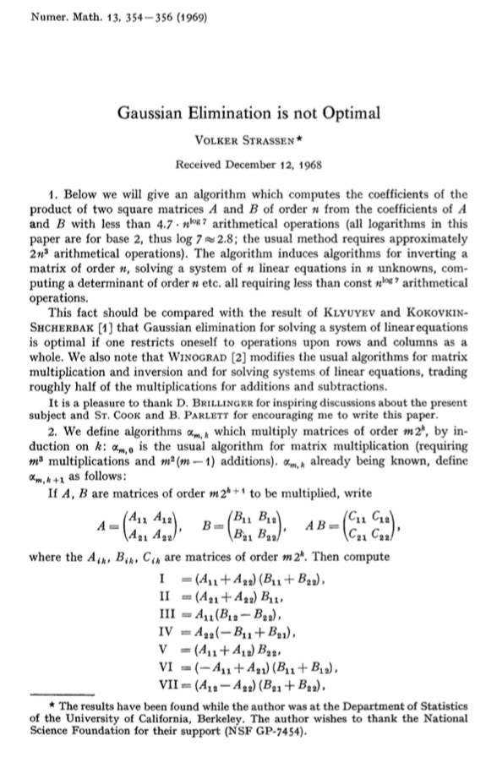
*Overlook of the Bay Area. Photo taken in Mission Peak Regional Preserve, Fremont, CA. Summer 2014.
STRASSEN, from 30,000 feet
Volker Strassen
(Born in 1936, aged 80)
Original Strassen Paper (1969)

Slide 3
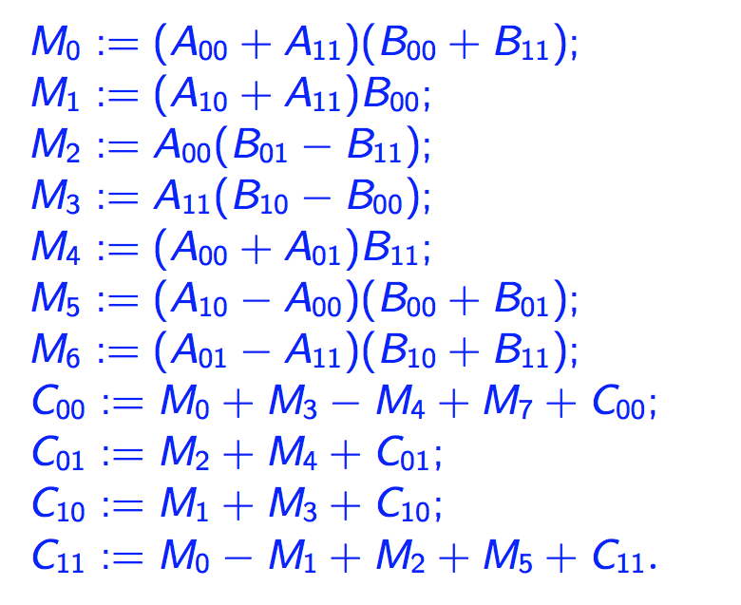
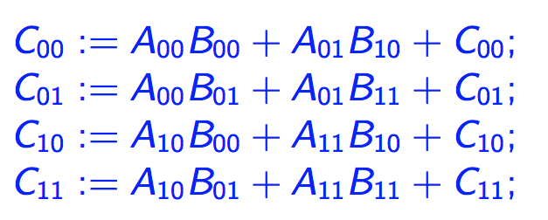
One-level Strassen’s Algorithm (In theory)
Direct Computation
Strassen’s Algorithm
8 multiplications, 8 additions
7 multiplications, 22 additions
*Strassen, Volker. "Gaussian elimination is not optimal." Numerische Mathematik 13, no. 4 (1969): 354-356.

Slide 4
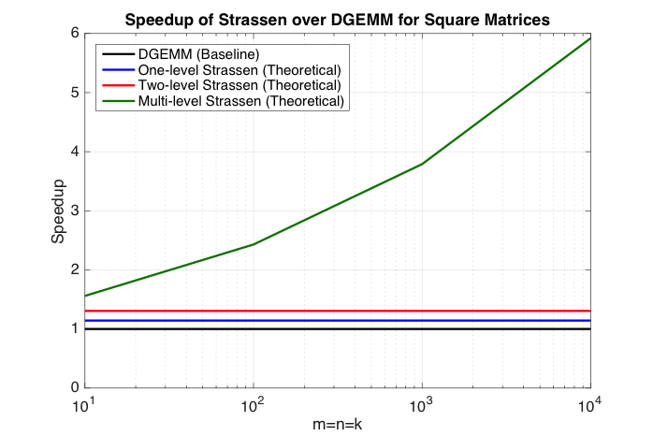
Multi-level Strassen’s Algorithm (In theory)
M₀ := (A₀₀+A₁₁)(B₀₀+B₁₁);
M₁ := (A₁₀+A₁₁)B₀₀;
M₂ := A₀₀(B₀₁–B₁₁);
M₃ := A₁₁(B₁₀–B₀₀);
M₄ := (A₀₀+A₀₁)B₁₁;
M₅ := (A₁₀–A₀₀)(B₀₀+B₀₁);
M₆ := (A₀₁–A₁₁)(B₁₀+B₁₁);
C₀₀ += M₀ + M₃ – M₄ + M₇
C₀₁ += M₂ + M₄
C₁₀ += M₁ + M₃
C₁₁ += M₀ – M₁ + M₂ + M₅
One-level Strassen (1+14.3% speedup)
8 multiplications → 7 multiplications ;
Two-level Strassen (1+30.6% speedup)
64 multiplications → 49 multiplications;
d-level Strassen (n³/n^{2.803} speedup)
8^{d} multiplications → 7^{d} multiplications;

Slide 5
Multi-level Strassen’s Algorithm (In theory)
M₀ := (A₀₀+A₁₁)(B₀₀+B₁₁);
M₁ := (A₁₀+A₁₁)B₀₀;
M₂ := A₀₀(B₀₁–B₁₁);
M₃ := A₁₁(B₁₀–B₀₀);
M₄ := (A₀₀+A₀₁)B₁₁;
M₅ := (A₁₀–A₀₀)(B₀₀+B₀₁);
M₆ := (A₀₁–A₁₁)(B₁₀+B₁₁);
C₀₀ += M₀ + M₃ – M₄ + M₇
C₀₁ += M₂ + M₄
C₁₀ += M₁ + M₃
C₁₁ += M₀ – M₁ + M₂ + M₅
One-level Strassen (1+14.3% speedup)
8 multiplications → 7 multiplications ;
Two-level Strassen (1+30.6% speedup)
64 multiplications → 49 multiplications;
d-level Strassen (n³/n^{2.803} speedup)
8^{d} multiplications → 7^{d} multiplications;
Numerical stability:
*Grey Ballard, Austin R. Benson, Alex Druinsky, Benjamin Lipshitz, and Oded Schwartz. "Improving the numerical stability of fast matrix multiplication algorithms." arXiv preprint arXiv:1507.00687 (2015).
*James Demmel, Ioana Dumitriu, Olga Holtz, and Robert Kleinberg. "Fast matrix multiplication is stable." Numerische Mathematik 106, no. 2 (2007): 199-224.
*Nicholas J. Higham, Accuracy and stability of numerical algorithms. SIAM, 2002.

Slide 6
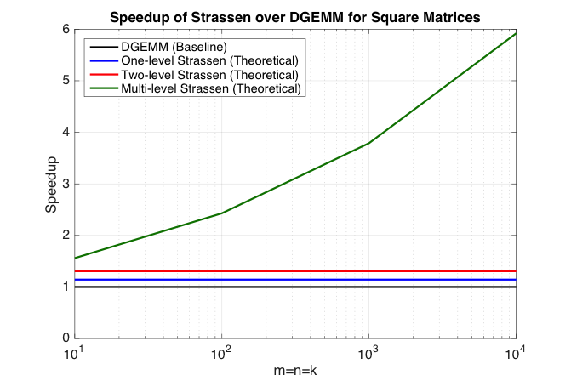
Strassen’s Algorithm (In practice)
M₀ := (A₀₀+A₁₁)(B₀₀+B₁₁);
M₁ := (A₁₀+A₁₁)B₀₀;
M₂ := A₀₀(B₀₁–B₁₁);
M₃ := A₁₁(B₁₀–B₀₀);
M₄ := (A₀₀+A₀₁)B₁₁;
M₅ := (A₁₀–A₀₀)(B₀₀+B₀₁);
M₆ := (A₀₁–A₁₁)(B₁₀+B₁₁);
C₀₀ += M₀ + M₃ – M₄ + M₇
C₀₁ += M₂ + M₄
C₁₀ += M₁ + M₃
C₁₁ += M₀ – M₁ + M₂ + M₅

Slide 7
Strassen’s Algorithm (In practice)
T₀
T₁
M₀ := (A₀₀+A₁₁)(B₀₀+B₁₁);
M₁ := (A₁₀+A₁₁)B₀₀;
M₂ := A₀₀(B₀₁–B₁₁);
M₃ := A₁₁(B₁₀–B₀₀);
M₄ := (A₀₀+A₀₁)B₁₁;
M₅ := (A₁₀–A₀₀)(B₀₀+B₀₁);
M₆ := (A₀₁–A₁₁)(B₁₀+B₁₁);
C₀₀ += M₀ + M₃ – M₄ + M₇
C₀₁ += M₂ + M₄
C₁₀ += M₁ + M₃
C₁₁ += M₀ – M₁ + M₂ + M₅
T₂
One-level Strassen (1+14.3% speedup)
7 multiplications + 22 additions;
Two-level Strassen (1+30.6% speedup)
49 multiplications + 344 additions;
d-level Strassen (n³/n^{2.803} speedup)
Numerical unstable; Not achievable
T₃
T₄
T₅
T₆
T₇
T₈
T₉

Slide 8
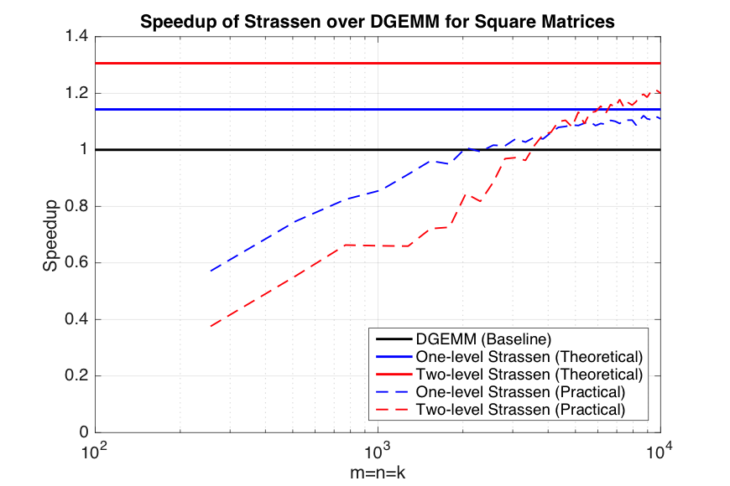
Strassen’s Algorithm (In practice)
T₀
T₁
M₀ := (A₀₀+A₁₁)(B₀₀+B₁₁);
M₁ := (A₁₀+A₁₁)B₀₀;
M₂ := A₀₀(B₀₁–B₁₁);
M₃ := A₁₁(B₁₀–B₀₀);
M₄ := (A₀₀+A₀₁)B₁₁;
M₅ := (A₁₀–A₀₀)(B₀₀+B₀₁);
M₆ := (A₀₁–A₁₁)(B₁₀+B₁₁);
C₀₀ += M₀ + M₃ – M₄ + M₇
C₀₁ += M₂ + M₄
C₁₀ += M₁ + M₃
C₁₁ += M₀ – M₁ + M₂ + M₅
T₂
One-level Strassen (1+14.3% speedup)
7 multiplications + 22 additions;
Two-level Strassen (1+30.6% speedup)
49 multiplications + 344 additions;
d-level Strassen (n³/n^{2.803} speedup)
Numerical unstable; Not achievable
T₃
T₄
T₅
T₆
T₇
T₈
T₉

Slide 9
To achieve practical high performance
of Strassen’s algorithm…...
Conventional Implementations
Our Implementations
Matrix Size
Must be large
Matrix Shape
Must be square
Memory movement
No Additional
Workspace
Padding
Buffers
Parallelism

Slide 10
To achieve practical high performance
of Strassen’s algorithm…...
Conventional Implementations
Our Implementations
Matrix Size
Must be large
Matrix Shape
Must be square
Memory movement
No Additional
Workspace
Padding
Buffers
Parallelism
Usually task parallelism

Slide 11
To achieve practical high performance
of Strassen’s algorithm…...
Conventional Implementations
Our Implementations
Matrix Size
Must be large
Matrix Shape
Must be square
Memory movement
No Additional
Workspace
Padding
Buffers
Parallelism
Usually task parallelism
Can be data parallelism

Slide 12
Outline
Standard Matrix-matrix multiplication
Strassen’s Algorithm Reloaded
High-performance Implementations
Theoretical Model and Analysis
Performance Experiments
Conclusion

Slide 13
Level-3 BLAS matrix-matrix multiplication (GEMM)
(General) matrix-matrix multiplication (GEMM) is supported in the level-3 BLAS* interface as
Ignoring transa and transb, GEMM computes
We consider the simplified version of GEMM
*Dongarra, Jack J., et al. "A set of level 3 basic linear algebra subprograms."ACM Transactions on Mathematical Software (TOMS) 16.1 (1990): 1-17.

Slide 14
State-of-the-art GEMM in BLIS
BLAS-like Library Instantiation Software (BLIS) is a portable framework for instantiating BLAS-like dense linear algebra libraries.
BLIS provides a refactoring of GotoBLAS algorithm (best-known approach) to implement GEMM.
GEMM implementation in BLIS has 6-layers of loops. The outer 5 loops are written in C. The inner-most loop (micro-kernel) is written in assembly for high performance.
Partition matrices into smaller blocks to fit into the different memory hierarchy.
The order of these loops is designed to utilize the cache reuse rate.
BLIS opens the black box of GEMM, leading to many applications built on BLIS.
Field Van Zee, and Robert van de Geijn. “BLIS: A Framework for Rapidly Instantiating BLAS Functionality." ACM TOMS 41.3 (2015): 14.
Kazushige Goto, and Robert van de Geijn. "High-performance implementation of the level-3 BLAS." ACM TOMS 35.1 (2008): 4.
Kazushige Goto, and Robert van de Geijn. "Anatomy of high-performance matrix multiplication." ACM TOMS 34.3 (2008): 12.
Chenhan D. Yu, *Jianyu Huang, Woody Austin, Bo Xiao, and George Biros. "Performance optimization for the k-nearest neighbors kernel on x86 architectures." In SC’15, p. 7. ACM, 2015.
*Jianyu Huang, Tyler Smith, Greg Henry, and Robert van de Geijn. “Strassen’s Algorithm Reloaded.” In submission to SC’16.
Devin Matthews, Field Van Zee, and Robert van de Geijn. “High-Performance Tensor Contraction without BLAS.” In submission to SC’16

Slide 15
State-of-the-art GEMM in BLIS
BLAS-like Library Instantiation Software (BLIS) is a portable framework for instantiating BLAS-like dense linear algebra libraries.
BLIS provides a refactoring of GotoBLAS algorithm (best-known approach) to implement GEMM.
GEMM implementation in BLIS has 6-layers of loops. The outer 5 loops are written in C. The inner-most loop (micro-kernel) is written in assembly for high performance.
Partition matrices into smaller blocks to fit into the different memory hierarchy.
The order of these loops is designed to utilize the cache reuse rate.
BLIS opens the black box of GEMM, leading to many applications built on BLIS.
Field Van Zee, and Robert van de Geijn. “BLIS: A Framework for Rapidly Instantiating BLAS Functionality." ACM TOMS 41.3 (2015): 14.
Kazushige Goto, and Robert van de Geijn. "High-performance implementation of the level-3 BLAS." ACM TOMS 35.1 (2008): 4.
Kazushige Goto, and Robert van de Geijn. "Anatomy of high-performance matrix multiplication." ACM TOMS 34.3 (2008): 12.
Chenhan D. Yu, *Jianyu Huang, Woody Austin, Bo Xiao, and George Biros. "Performance optimization for the k-nearest neighbors kernel on x86 architectures." In SC’15, p. 7. ACM, 2015.
*Jianyu Huang, Tyler Smith, Greg Henry, and Robert van de Geijn. “Strassen’s Algorithm Reloaded.” In submission to SC’16.
Devin Matthews, Field Van Zee, and Robert van de Geijn. “High-Performance Tensor Contraction without BLAS.” In submission to SC’16

Slide 16
Memory Hierarchy
Ivy Bridge
Xeon Phi
Register
AVX256
AVX512
Smaller,
Faster
32 KB
32 KB
L1 cache
256 KB
512 KB
L2 cache
L3 cache
25.6 MB
----
Main memory
128 GB
8 GB

Slide 17
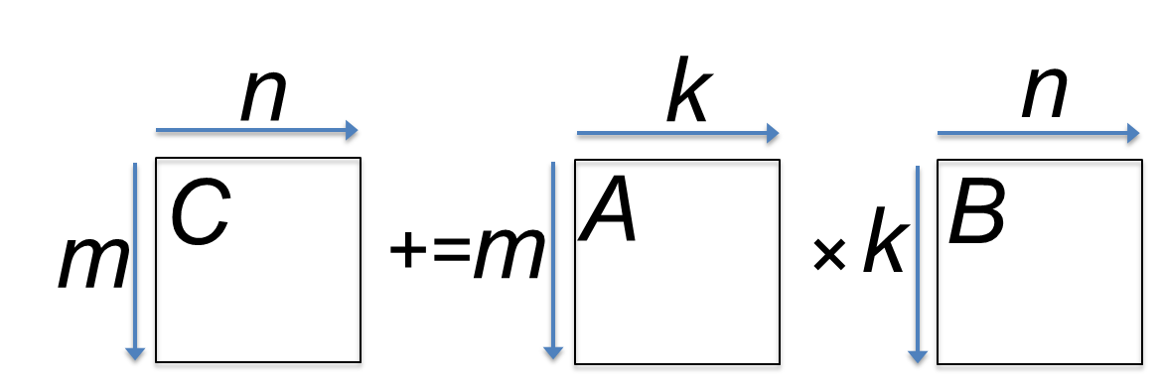
GotoBLAS algorithm for GEMM in BLIS
*Field G. Van Zee, and Tyler M. Smith. “Implementing high-performance complex matrix multiplication." In ACM Transactions on Mathematical Software (TOMS), accepted pending modifications.

Slide 18
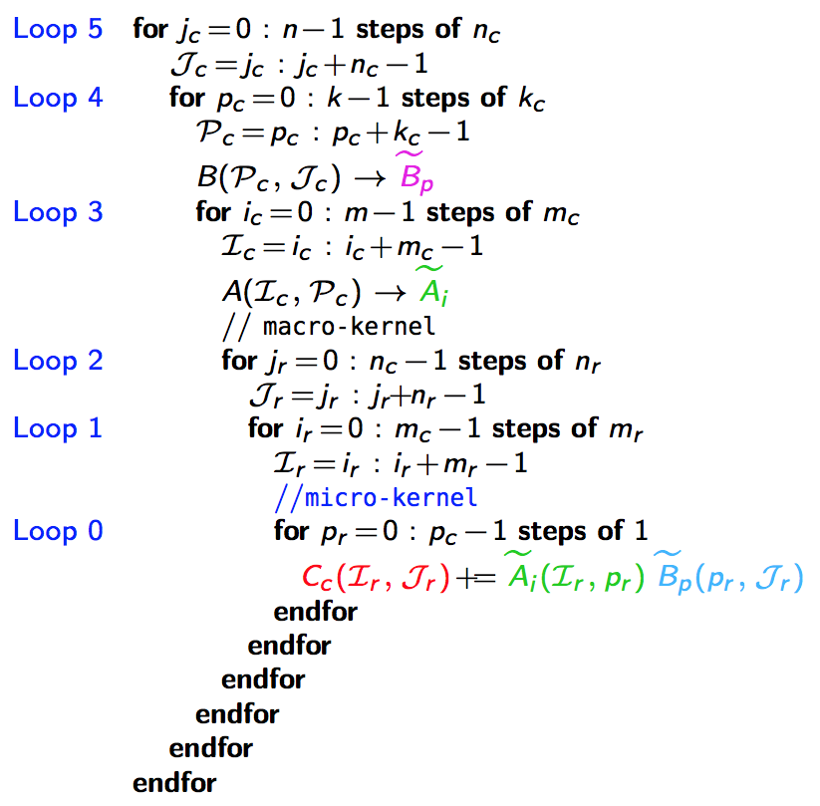
n_{C}
5th loop around micro-kernel
n_{C}
GotoBLAS algorithm for GEMM in BLIS
C_{j}
A
B_{j}
n_{C}
+=
n_{C}
main memory
*Field G. Van Zee, and Tyler M. Smith. “Implementing high-performance complex matrix multiplication." In ACM Transactions on Mathematical Software (TOMS), accepted pending modifications.

Slide 19
n_{C}
5th loop around micro-kernel
n_{C}
GotoBLAS algorithm for GEMM in BLIS
C_{j}
A
B_{j}
n_{C}
+=
n_{C}
4th loop around micro-kernel
C_{j}
A_{p}
k_{C}
B_{p}
+=
k_{C}
~
Pack B_{p} → B_{p}
~
B_{p}
main memory
L3 cache
*Field G. Van Zee, and Tyler M. Smith. “Implementing high-performance complex matrix multiplication." In ACM Transactions on Mathematical Software (TOMS), accepted pending modifications.

Slide 20
n_{C}
5th loop around micro-kernel
n_{C}
GotoBLAS algorithm for GEMM in BLIS
C_{j}
A
B_{j}
n_{C}
+=
n_{C}
4th loop around micro-kernel
C_{j}
A_{p}
k_{C}
B_{p}
+=
k_{C}
~
3rd loop around micro-kernel
Pack B_{p} → B_{p}
C_{i}
m_{C}
A_{i}
~
m_{C}
B_{p}
+=
~
Pack A_{i}→ A_{i}
~
A_{i}
m_{R}
k_{C}
main memory
L3 cache
L2 cache
*Field G. Van Zee, and Tyler M. Smith. “Implementing high-performance complex matrix multiplication." In ACM Transactions on Mathematical Software (TOMS), accepted pending modifications.

Slide 21
n_{C}
5th loop around micro-kernel
n_{C}
GotoBLAS algorithm for GEMM in BLIS
C_{j}
A
B_{j}
n_{C}
+=
n_{C}
4th loop around micro-kernel
C_{j}
A_{p}
k_{C}
B_{p}
+=
k_{C}
~
3rd loop around micro-kernel
Pack B_{p} → B_{p}
C_{i}
m_{C}
A_{i}
~
m_{C}
B_{p}
+=
~
Pack A_{i}→ A_{i}
n_{R}
2nd loop around micro-kernel
~
n_{R}
~
A_{i}
B_{p}
C_{i}
m_{R}
+=
k_{C}
main memory
L3 cache
L2 cache
*Field G. Van Zee, and Tyler M. Smith. “Implementing high-performance complex matrix multiplication." In ACM Transactions on Mathematical Software (TOMS), accepted pending modifications.

Slide 22
n_{C}
5th loop around micro-kernel
n_{C}
GotoBLAS algorithm for GEMM in BLIS
C_{j}
A
B_{j}
n_{C}
+=
n_{C}
4th loop around micro-kernel
C_{j}
A_{p}
k_{C}
B_{p}
+=
k_{C}
~
3rd loop around micro-kernel
Pack B_{p} → B_{p}
C_{i}
m_{C}
A_{i}
~
m_{C}
B_{p}
+=
~
Pack A_{i}→ A_{i}
n_{R}
2nd loop around micro-kernel
~
n_{R}
~
A_{i}
B_{p}
C_{i}
m_{R}
+=
k_{C}
1st loop around micro-kernel
n_{R}
m_{R}
+=
Update C_{ij}
k_{C}
main memory
L3 cache
L2 cache
L1 cache
*Field G. Van Zee, and Tyler M. Smith. “Implementing high-performance complex matrix multiplication." In ACM Transactions on Mathematical Software (TOMS), accepted pending modifications.
registers

Slide 23
n_{C}
5th loop around micro-kernel
n_{C}
GotoBLAS algorithm for GEMM in BLIS
C_{j}
A
B_{j}
n_{C}
+=
n_{C}
4th loop around micro-kernel
C_{j}
A_{p}
k_{C}
B_{p}
+=
k_{C}
~
3rd loop around micro-kernel
Pack B_{p} → B_{p}
C_{i}
m_{C}
A_{i}
~
m_{C}
B_{p}
+=
~
Pack A_{i}→ A_{i}
n_{R}
2nd loop around micro-kernel
~
n_{R}
~
A_{i}
B_{p}
C_{i}
m_{R}
+=
k_{C}
1st loop around micro-kernel
n_{R}
m_{R}
+=
Update C_{ij}
k_{C}
micro-kernel
main memory
1
L3 cache
+=
L2 cache
1
L1 cache
*Field G. Van Zee, and Tyler M. Smith. “Implementing high-performance complex matrix multiplication." In ACM Transactions on Mathematical Software (TOMS), accepted pending modifications.
registers

Slide 24
n_{C}
5th loop around micro-kernel
n_{C}
GotoBLAS algorithm for GEMM in BLIS
C_{j}
A
B_{j}
n_{C}
+=
n_{C}
4th loop around micro-kernel
C_{j}
A_{p}
k_{C}
B_{p}
+=
k_{C}
~
3rd loop around micro-kernel
Pack B_{p} → B_{p}
C_{i}
m_{C}
A_{i}
~
m_{C}
B_{p}
+=
~
Pack A_{i}→ A_{i}
n_{R}
2nd loop around micro-kernel
~
n_{R}
~
A_{i}
B_{p}
C_{i}
m_{R}
+=
k_{C}
1st loop around micro-kernel
n_{R}
m_{R}
+=
Update C_{ij}
k_{C}
micro-kernel
main memory
1
L3 cache
+=
L2 cache
1
L1 cache
*Field G. Van Zee, and Tyler M. Smith. “Implementing high-performance complex matrix multiplication." In ACM Transactions on Mathematical Software (TOMS), accepted pending modifications.
registers

Slide 25
Outline
Conventional Matrix-matrix multiplication
Strassen’s Algorithm Reloaded
High-performance Implementations
Theoretical Model and Analysis
Performance Experiments
Conclusion

Slide 26
One-level Strassen’s Algorithm Reloaded
M₀ := α(A₀₀+A₁₁)(B₀₀+B₁₁);
M₁ := α(A₁₀+A₁₁)B₀₀;
M₂ := αA₀₀(B₀₁–B₁₁);
M₃ := αA₁₁(B₁₀–B₀₀);
M₄ := α(A₀₀+A₀₁)B₁₁;
M₅ := α(A₁₀–A₀₀)(B₀₀+B₀₁);
M₆ := α(A₀₁–A₁₁)(B₁₀+B₁₁);
C₀₀ += M₀ + M₃ – M₄ + M₇
C₀₁ += M₂ + M₄
C₁₀ += M₁ + M₃
C₁₁ += M₀ – M₁ + M₂ + M₅
M₀ := α(A₀₀+A₁₁)(B₀₀+B₁₁); C₀₀ += M₀; C₁₁ += M₀;
M₁ := α(A₁₀+A₁₁)B₀₀; C₁₀ += M₁; C₁₁ –= M₁;
M₂ := αA₀₀(B₀₁–B₁₁); C₀₁ += M₂; C₁₁ += M₂;
M₃ := αA₁₁(B₁₀–B₀₀); C₀₀ += M₃; C₁₀ += M₃;
M₄ := α(A₀₀+A₀₁)B₁₁; C₀₁ += M₄; C₀₀ –= M₄;
M₅ := α(A₁₀–A₀₀)(B₀₀+B₀₁); C₁₁ += M₅;
M₆ := α(A₀₁–A₁₁)(B₁₀+B₁₁); C₀₀ += M₆;
M := α(X+Y)(V+W); C +=M; D +=M;
General operation for one-level Strassen:
M := α(X+δY)(V+εW); C += γ₀M; D += γ₁M;
γ₀, γ₁,δ,ε ∈ {-1, 0, 1}.

Slide 27
High-performance implementation of the general operation?
M := α(X+δY)(V+εW); C += γ₀M; D += γ₁M;
γ₀, γ₁,δ,ε ∈ {-1, 0, 1}.
*http://shpc.ices.utexas.edu/index.html

Slide 28
M := α(X+δY)(V+εW); C += γ₀M; D += γ₁M;
γ₀, γ₁,δ,ε ∈ {-1, 0, 1}.
*Jianyu Huang, Tyler Smith, Greg Henry, and Robert van de Geijn. “Strassen’s Algorithm Reloaded.” In submission to SC’16.

Slide 29
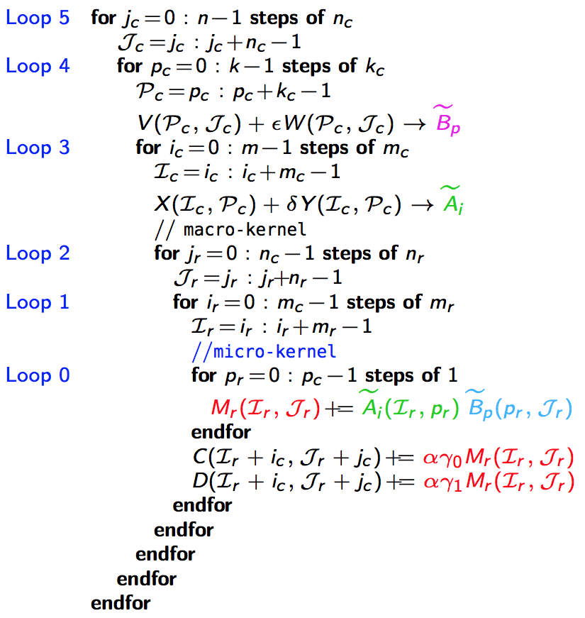
M := α(X+δY)(V+εW); C += γ₀M; D += γ₁M;
γ₀, γ₁,δ,ε ∈ {-1, 0, 1}.
5th loop around micro-kernel
n_{C}
n_{C}
D_{j}
Y
W
n_{C}
n_{C}
C_{j}
+=
X
V_{j}
main memory
*Jianyu Huang, Tyler Smith, Greg Henry, and Robert van de Geijn. “Strassen’s Algorithm Reloaded.” In submission to SC’16.

Slide 30
M := α(X+δY)(V+εW); C += γ₀M; D += γ₁M;
γ₀, γ₁,δ,ε ∈ {-1, 0, 1}.
5th loop around micro-kernel
n_{C}
n_{C}
D_{j}
Y
W
n_{C}
n_{C}
C_{j}
+=
X
V_{j}
4th loop around micro-kernel
D_{j}
Y_{p}
k_{C}
W_{p}
C_{j}
+=
X_{p}
V_{p}
k_{C}
~
Pack V_{p} + εW_{p} → B_{p}
~
B_{p}
main memory
L3 cache
*Jianyu Huang, Tyler Smith, Greg Henry, and Robert van de Geijn. “Strassen’s Algorithm Reloaded.” In submission to SC’16.

Slide 31
M := α(X+δY)(V+εW); C += γ₀M; D += γ₁M;
γ₀, γ₁,δ,ε ∈ {-1, 0, 1}.
5th loop around micro-kernel
n_{C}
n_{C}
D_{j}
Y
W
n_{C}
n_{C}
C_{j}
+=
X
V_{j}
4th loop around micro-kernel
D_{j}
Y_{p}
k_{C}
W_{p}
C_{j}
+=
X_{p}
V_{p}
k_{C}
~
3rd loop around micro-kernel
Pack V_{p} + εW_{p} → B_{p}
D_{i}
m_{C}
Y_{i}
~
C_{i}
X_{i}
B_{p}
m_{C}
+=
~
Pack X_{i} + δY_{i}→ A_{i}
~
A_{i}
m_{R}
k_{C}
main memory
L3 cache
L2 cache
*Jianyu Huang, Tyler Smith, Greg Henry, and Robert van de Geijn. “Strassen’s Algorithm Reloaded.” In submission to SC’16.

Slide 32
M := α(X+δY)(V+εW); C += γ₀M; D += γ₁M;
γ₀, γ₁,δ,ε ∈ {-1, 0, 1}.
5th loop around micro-kernel
n_{C}
n_{C}
D_{j}
Y
W
n_{C}
n_{C}
C_{j}
+=
X
V_{j}
4th loop around micro-kernel
D_{j}
Y_{p}
k_{C}
W_{p}
C_{j}
+=
X_{p}
V_{p}
k_{C}
~
3rd loop around micro-kernel
Pack V_{p} + εW_{p} → B_{p}
D_{i}
m_{C}
Y_{i}
~
C_{i}
X_{i}
B_{p}
m_{C}
+=
~
Pack X_{i} + δY_{i}→ A_{i}
n_{R}
2nd loop around micro-kernel
~
n_{R}
~
A_{i}
B_{p}
D_{i}
m_{R}
+=
C_{i}
k_{C}
main memory
L3 cache
L2 cache
*Jianyu Huang, Tyler Smith, Greg Henry, and Robert van de Geijn. “Strassen’s Algorithm Reloaded.” In submission to SC’16.

Slide 33
M := α(X+δY)(V+εW); C += γ₀M; D += γ₁M;
γ₀, γ₁,δ,ε ∈ {-1, 0, 1}.
5th loop around micro-kernel
n_{C}
n_{C}
D_{j}
Y
W
n_{C}
n_{C}
C_{j}
+=
X
V_{j}
4th loop around micro-kernel
D_{j}
Y_{p}
k_{C}
W_{p}
C_{j}
+=
X_{p}
V_{p}
k_{C}
~
3rd loop around micro-kernel
Pack V_{p} + εW_{p} → B_{p}
D_{i}
m_{C}
Y_{i}
~
C_{i}
X_{i}
B_{p}
m_{C}
+=
~
Pack X_{i} + δY_{i}→ A_{i}
n_{R}
2nd loop around micro-kernel
~
n_{R}
~
A_{i}
B_{p}
D_{i}
m_{R}
+=
C_{i}
k_{C}
n_{R}
1st loop around micro-kernel
m_{R}
+=
Update C_{ij} , D_{ij}
k_{C}
main memory
L3 cache
L2 cache
L1 cache
*Jianyu Huang, Tyler Smith, Greg Henry, and Robert van de Geijn. “Strassen’s Algorithm Reloaded.” In submission to SC’16.
registers

Slide 34
M := α(X+δY)(V+εW); C += γ₀M; D += γ₁M;
γ₀, γ₁,δ,ε ∈ {-1, 0, 1}.
5th loop around micro-kernel
n_{C}
n_{C}
D_{j}
Y
W
n_{C}
n_{C}
C_{j}
+=
X
V_{j}
4th loop around micro-kernel
D_{j}
Y_{p}
k_{C}
W_{p}
C_{j}
+=
X_{p}
V_{p}
k_{C}
~
3rd loop around micro-kernel
Pack V_{p} + εW_{p} → B_{p}
D_{i}
m_{C}
Y_{i}
~
C_{i}
X_{i}
B_{p}
m_{C}
+=
~
Pack X_{i} + δY_{i}→ A_{i}
n_{R}
2nd loop around micro-kernel
~
n_{R}
~
A_{i}
B_{p}
D_{i}
m_{R}
+=
C_{i}
k_{C}
n_{R}
1st loop around micro-kernel
m_{R}
+=
Update C_{ij} , D_{ij}
k_{C}
micro-kernel
main memory
1
L3 cache
+=
L2 cache
1
L1 cache
*Jianyu Huang, Tyler Smith, Greg Henry, and Robert van de Geijn. “Strassen’s Algorithm Reloaded.” In submission to SC’16.
registers

Slide 35
M := α(X+δY)(V+εW); C += γ₀M; D += γ₁M;
γ₀, γ₁,δ,ε ∈ {-1, 0, 1}.
5th loop around micro-kernel
n_{C}
n_{C}
D_{j}
Y
W
n_{C}
n_{C}
C_{j}
+=
X
V_{j}
4th loop around micro-kernel
D_{j}
Y_{p}
k_{C}
W_{p}
C_{j}
+=
X_{p}
V_{p}
k_{C}
~
3rd loop around micro-kernel
Pack V_{p} + εW_{p} → B_{p}
D_{i}
m_{C}
Y_{i}
~
C_{i}
X_{i}
B_{p}
m_{C}
+=
~
Pack X_{i} + δY_{i}→ A_{i}
n_{R}
2nd loop around micro-kernel
~
n_{R}
~
A_{i}
B_{p}
D_{i}
m_{R}
+=
C_{i}
k_{C}
n_{R}
1st loop around micro-kernel
m_{R}
+=
Update C_{ij} , D_{ij}
k_{C}
micro-kernel
main memory
1
L3 cache
+=
L2 cache
1
L1 cache
*Jianyu Huang, Tyler Smith, Greg Henry, and Robert van de Geijn. “Strassen’s Algorithm Reloaded.” In submission to SC’16.
registers

Slide 36
n_{C}
5th loop around micro-kernel
n_{C}
n_{C}
5th loop around micro-kernel
n_{C}
C_{j}
A
B
D_{j}
Y
W
n_{C}
n_{C}
n_{C}
n_{C}
+=
C_{j}
+=
X
V_{j}
4th loop around micro-kernel
4th loop around micro-kernel
C_{j}
A_{p}
k_{C}
B_{p}
D_{j}
Y_{p}
k_{C}
W_{p}
+=
C_{j}
+=
X_{p}
V_{p}
k_{C}
k_{C}
~
~
3rd loop around micro-kernel
Pack B_{p} → B_{p}
3rd loop around micro-kernel
Pack V_{p} + εW_{p} → B_{p}
C_{i}
A_{i}
~
D_{i}
m_{C}
Y_{i}
~
m_{C}
m_{C}
B_{p}
C_{i}
X_{i}
B_{p}
m_{C}
+=
+=
~
~
Pack A_{i}→ A_{i}
Pack X_{i} + δY_{i}→ A_{i}
n_{R}
2nd loop around micro-kernel
~
n_{R}
~
n_{R}
2nd loop around micro-kernel
~
n_{R}
~
A_{i}
B_{p}
A_{i}
B_{p}
C_{i}
m_{R}
D_{i}
m_{R}
+=
+=
k_{C}
C_{i}
k_{C}
n_{R}
1st loop around micro-kernel
n_{R}
1st loop around micro-kernel
m_{R}
+=
m_{R}
+=
Update C_{ij}
k_{C}
Update C_{ij} , D_{ij}
k_{C}
micro-kernel
micro-kernel
main memory
1
main memory
1
L3 cache
+=
L3 cache
+=
L2 cache
1
L2 cache
1
L1 cache
L1 cache
registers
registers

Slide 37
Two-level Strassen’s Algorithm Reloaded

Slide 38
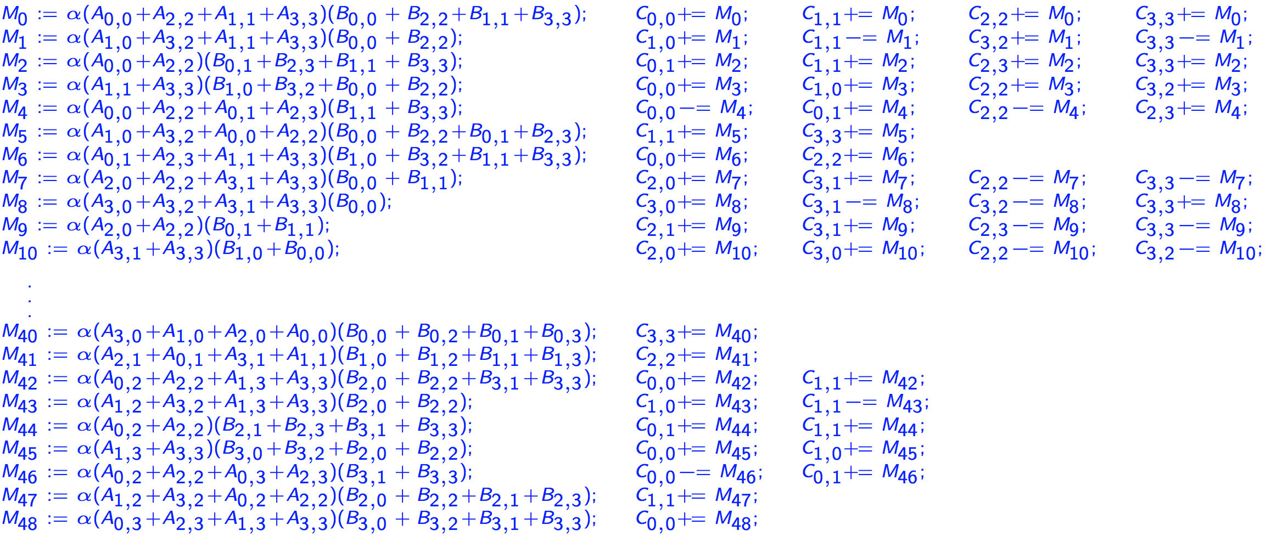
Two-level Strassen’s Algorithm Reloaded (Continue)
M := α(X₀+X₁+X₂+X₃)(V+V₁+V₂+V₃); C₀ += M; C₁ += M; C₂ += M; C₃ += M;
General operation for two-level Strassen:
M := α(X₀+δ₁X₁+δ₂X₂+δ₃X₃)(V+ε₁V₁+ε₂V₂+ε₃V₃); C₀ += γ₀M; C₁ += γ₁M; C₂ += γ₂M; C₃ += γ₃M;
γ_{i},δ_{i},ε_{i} ∈ {-1, 0, 1}.

Slide 39
Additional Levels of Strassen Reloaded
The general operation of one-level Strassen:
The general operation of two-level Strassen:
The general operation needed to integrate k levels of Strassen is given by
M := α(X+δY)(V+εW); C += γ₀M; D += γ₁M;
γ₀, γ₁,δ,ε ∈ {-1, 0, 1}.
M := α(X₀+δ₁X₁+δ₂X₂+δ₃X₃)(V+ε₁V₁+ε₂V₂+ε₃V₃);
C₀ += γ₀M; C₁ += γ₁M; C₂ += γ₂M; C₃ += γ₃M;
γ_{i},δ_{i},ε_{i} ∈ {-1, 0, 1}.

Slide 40
Outline
Conventional Matrix-matrix multiplication
Strassen’s Algorithm Reloaded
High-performance Implementations
Theoretical Model and Analysis
Performance Experiments
Conclusion

Slide 41
Building blocks
BLIS framework
Adapted to general operation
A routine for packing B_{p} into
C/Intel intrinsics
A routine for packing A_{i} into
C/Intel intrinsics
A micro-kernel for updating an m_{R}×n_{R} submatrix of C.
SIMD assembly (AVX, AVX512, etc)
Integrate the addition of multiple matrices V_{t} into
Integrate the addition of multiple matrices X_{s} into
Integrate the update of multiple submatrices of C.

Slide 42
Variations on a theme
Naïve Strassen
A traditional implementation with temporary buffers.
AB Strassen
Integrate the addition of matrices into and .
ABC Strassen
Integrate the addition of matrices into and .
Integrate the update of multiple submatrices of C in the micro-kernel.

Slide 43
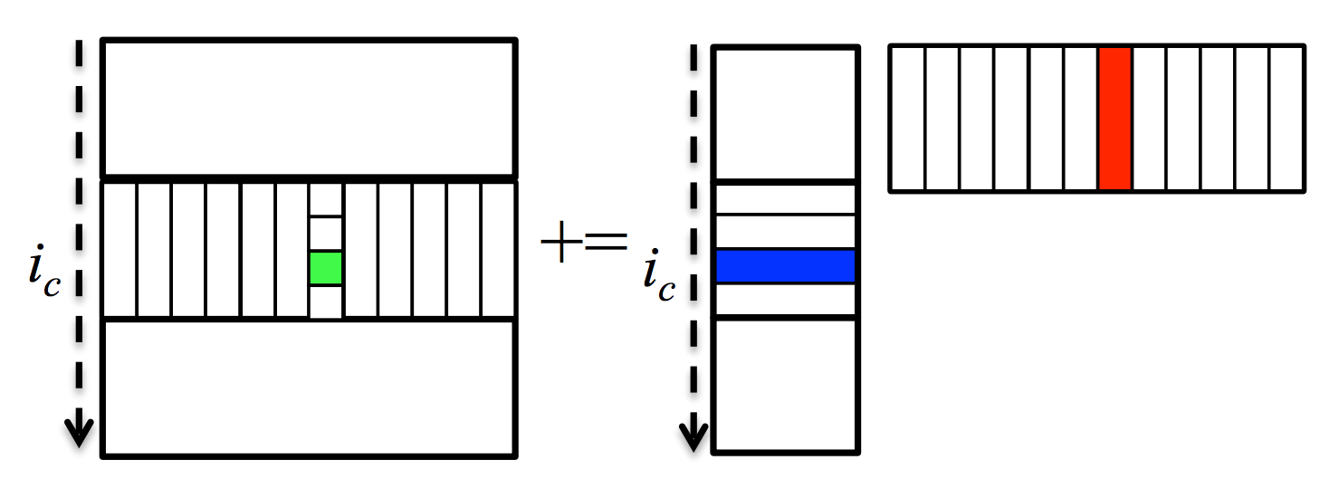
Parallelization
5th loop around micro-kernel
n_{C}
n_{C}
D_{j}
Y
W
n_{C}
n_{C}
C_{j}
+=
X
V_{j}
For architectures with independent L2 cache, we parallelize 3rd loop (along m_{C} direction)
For architectures with shared L2 cache, we parallelize 2nd loop (along n_{R} direction)
For many-core architecture (e.g. Xeon Phi, 240 threads), we parallelize both 3rd and 2nd loop
4th loop around micro-kernel
D_{j}
Y_{p}
k_{C}
W_{p}
C_{j}
+=
X_{p}
V_{p}
k_{C}
~
3rd loop around micro-kernel
Pack V_{p} + εW_{p} → B_{p}
D_{i}
m_{C}
Y_{i}
~
C_{i}
X_{i}
B_{p}
m_{C}
+=
~
Pack X_{i} + δY_{i}→ A_{i}
n_{R}
2nd loop around micro-kernel
~
n_{R}
~
A_{i}
B_{p}
D_{i}
m_{R}
+=
C_{i}
k_{C}
n_{R}
1st loop around micro-kernel
m_{R}
+=
Update C_{ij} , D_{ij}
k_{C}
micro-kernel
main memory
1
L3 cache
+=
*Tyler M. Smith, Robert Van De Geijn, Mikhail Smelyanskiy, Jeff R. Hammond, and Field G. Van Zee. "Anatomy of high-performance many-threaded matrix multiplication." In Parallel and Distributed Processing Symposium, 2014 IEEE 28th International, pp. 1049-1059. IEEE, 2014.
L2 cache
1
L1 cache
registers

Slide 44
Outline
Conventional Matrix-matrix multiplication
Strassen’s Algorithm Reloaded
High-performance Implementations
Theoretical Model and Analysis
Performance Experiments
Conclusion

Slide 45
Performance Model
Performance Metric
Total Time Breakdown
Arithmetic
Operations
Memory
Operations

Slide 46
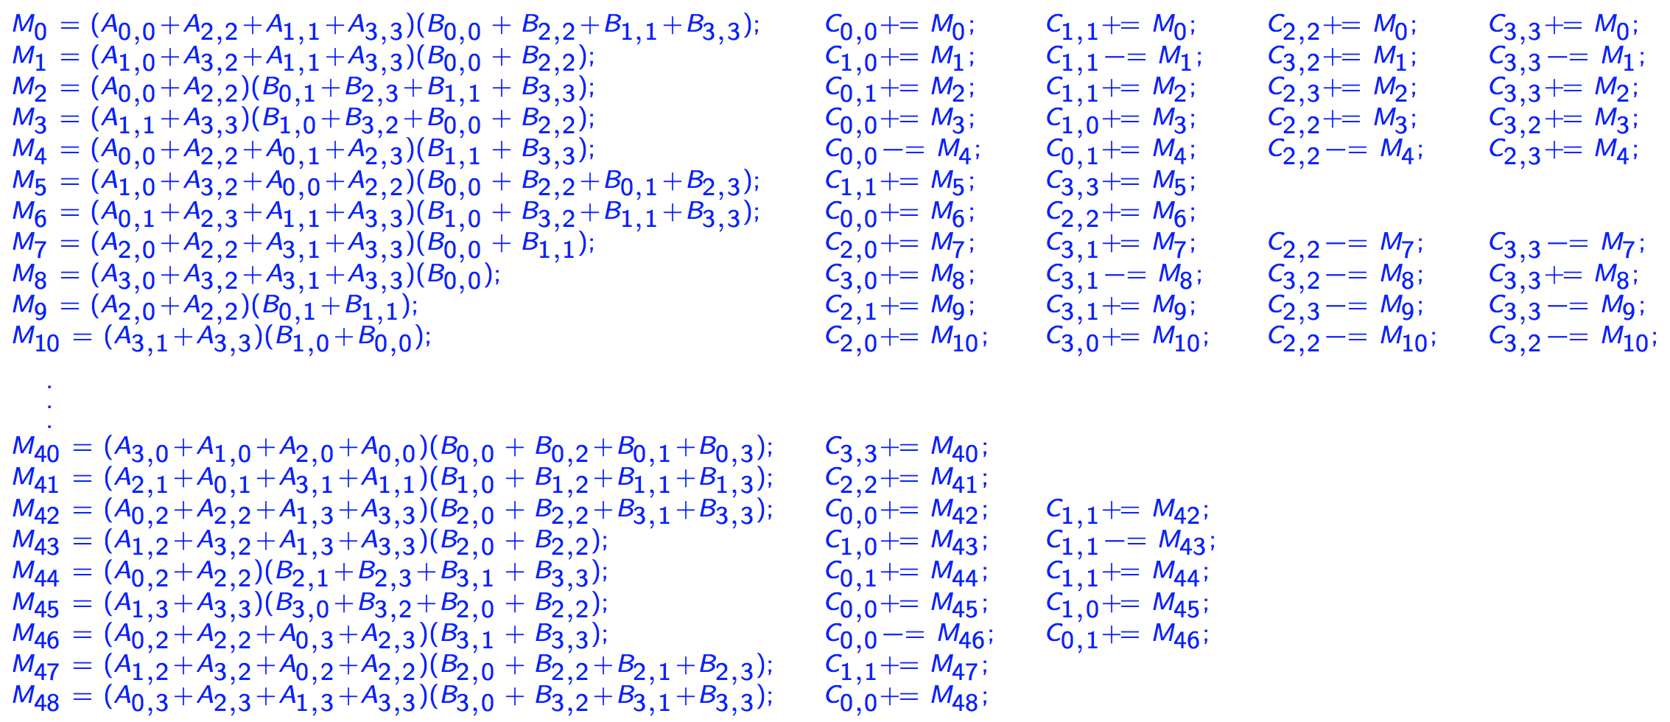
Arithmetic Operations
Submatrix
multiplication
Extra additions with submatrices of A, B, C, respectively
DGEMM
No extra additions
One-level Strassen (ABC, AB, Naïve)
7 submatrix multiplications
5 extra additions of submatrices of A and B
12 extra additions of submatrices of C
Two-level Strassen (ABC, AB, Naïve)
49 submatrix multiplications
95 extra additions of submatrices of A and B
154 extra additions of submatrices of C
unit time for one arithmetic operation
M₀ := α(A₀₀+A₁₁)(B₀₀+B₁₁); C₀₀ += M₀; C₁₁ += M₀;
M₁ := α(A₁₀+A₁₁)B₀₀; C₁₀ += M₁; C₁₁ –= M₁;
M₂ := αA₀₀(B₀₁–B₁₁); C₀₁ += M₂; C₁₁ += M₂;
M₃ := αA₁₁(B₁₀–B₀₀); C₀₀ += M₃; C₁₀ += M₃;
M₄ := α(A₀₀+A₀₁)B₁₁; C₀₁ += M₄; C₀₀ –= M₄;
M₅ := α(A₁₀–A₀₀)(B₀₀+B₀₁); C₁₁ += M₅;
M₆ := α(A₀₁–A₁₁)(B₁₀+B₁₁); C₀₀ += M₆;

Slide 47
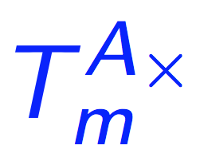
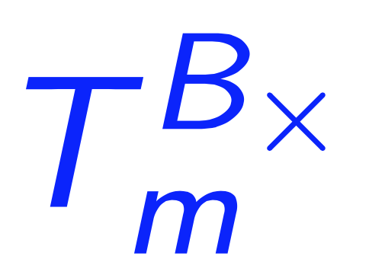
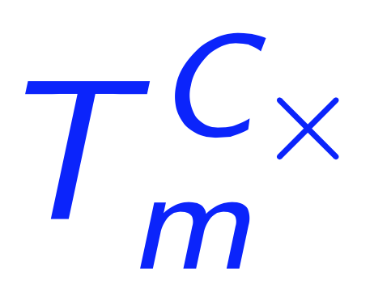
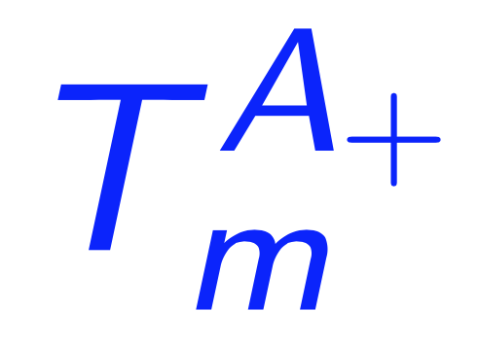
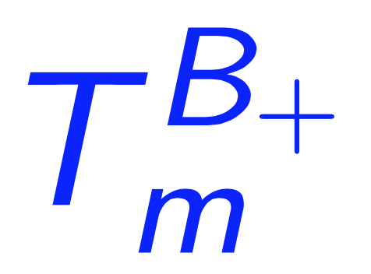
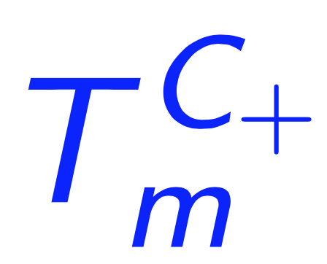
Memory Operations
Assumption
Simplified memory hierarchy model (fast caches + slow main memory)
R/W fast caches is overlapped with computations.
Dominant memory operations
Memory packing in DGEMM/adapted general operaton routine
Reading/writing submatrices of C in (adapted) routine
Reading/writing of the temporary buffer that are part of Naïve Strassen and AB Strassen.

Slide 48
Memory Operations
DGEMM
One-level
ABC Strassen
AB Strassen
Naïve Strassen
λ∈ [0.5, 1], software prefetching efficiency
bandwidth
step function: periodical spikes

Slide 49
Memory Operations
DGEMM
One-level
ABC Strassen
AB Strassen
Naïve Strassen
Two-level
ABC Strassen
AB Strassen
Naïve Strassen
λ∈ [0.5, 1], software prefetching efficiency
bandwidth
step function: periodical spikes

Slide 50
Modeled and Actual Performance on Single Core

Slide 51
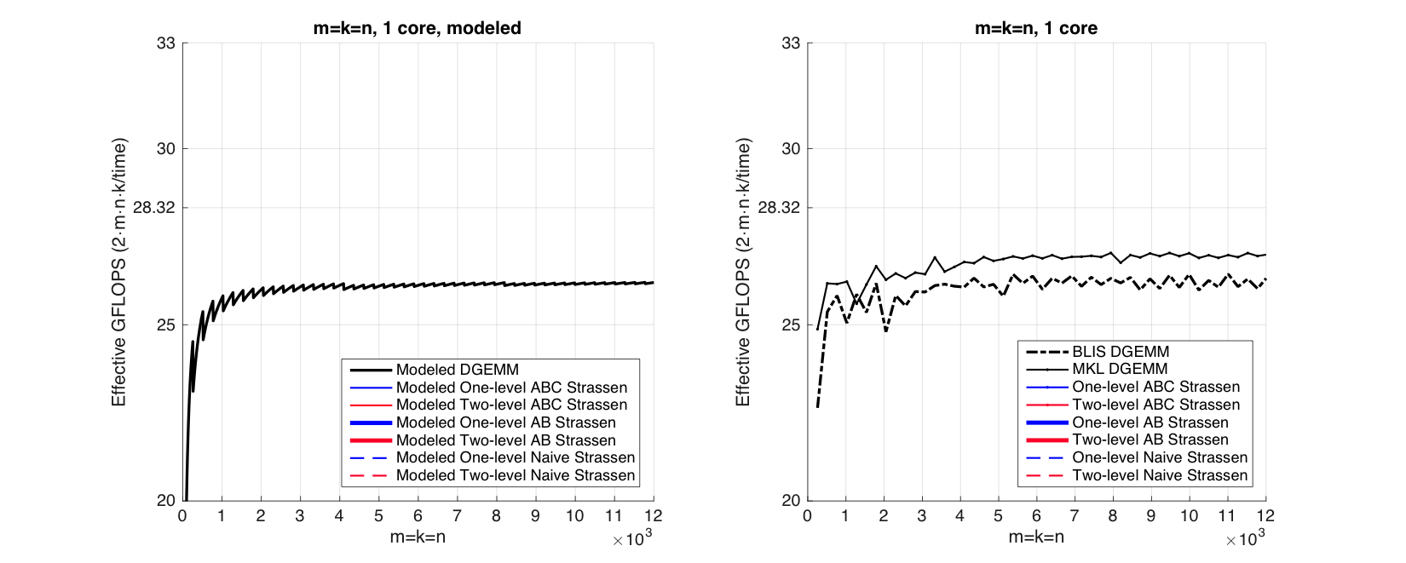
Observation (Square Matrices)
Modeled Performance
Actual Performance

Slide 52
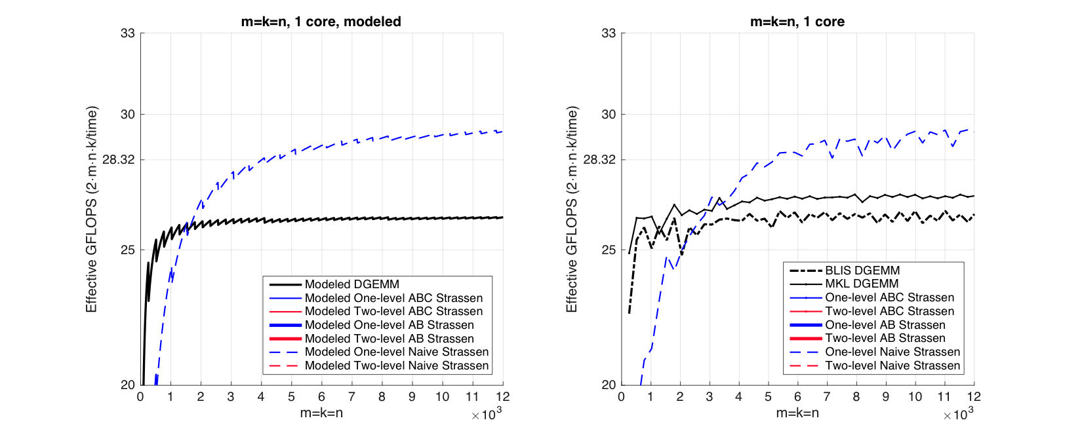
Observation (Square Matrices)
Modeled Performance
Actual Performance

Slide 53
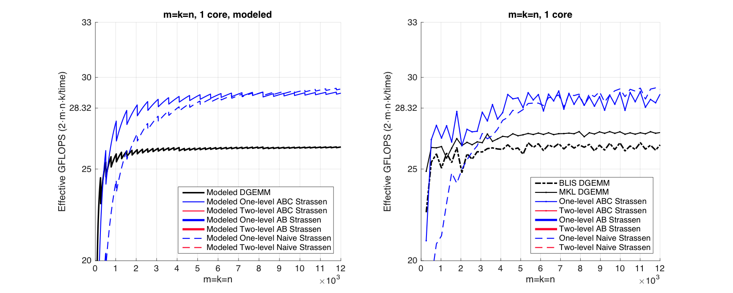
Observation (Square Matrices)
Modeled Performance
Actual Performance

Slide 54
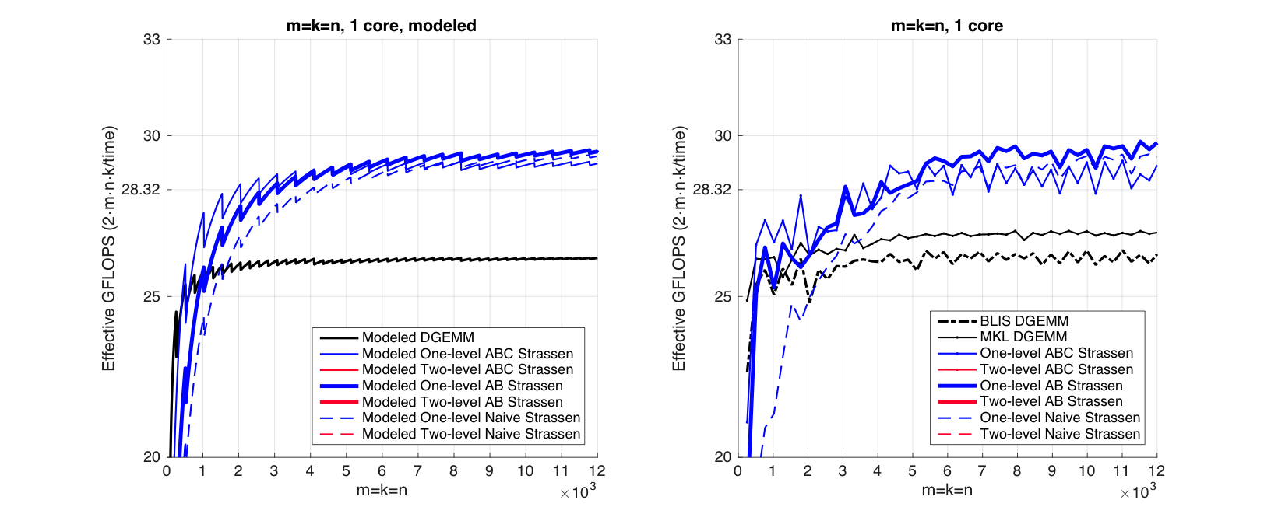
Observation (Square Matrices)
Modeled Performance
Actual Performance

Slide 55
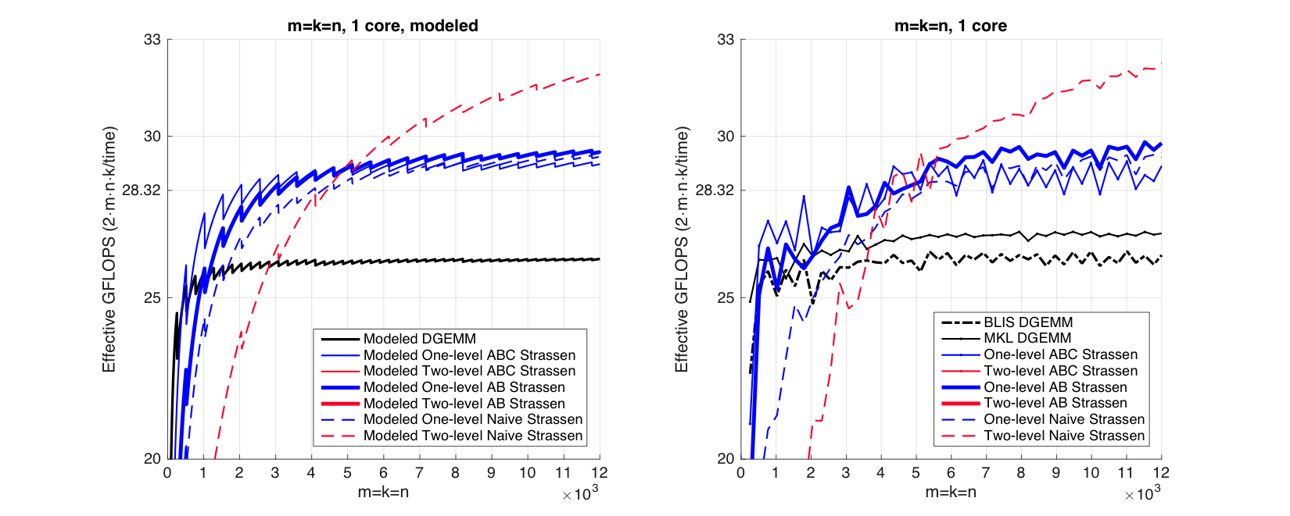
Observation (Square Matrices)
Modeled Performance
Actual Performance

Slide 56
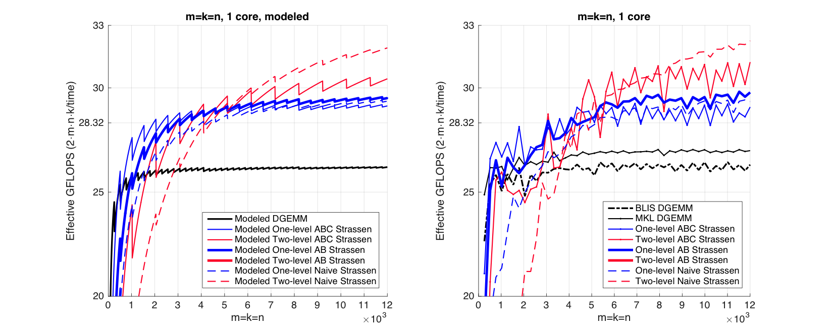
Observation (Square Matrices)
Modeled Performance
Actual Performance

Slide 57
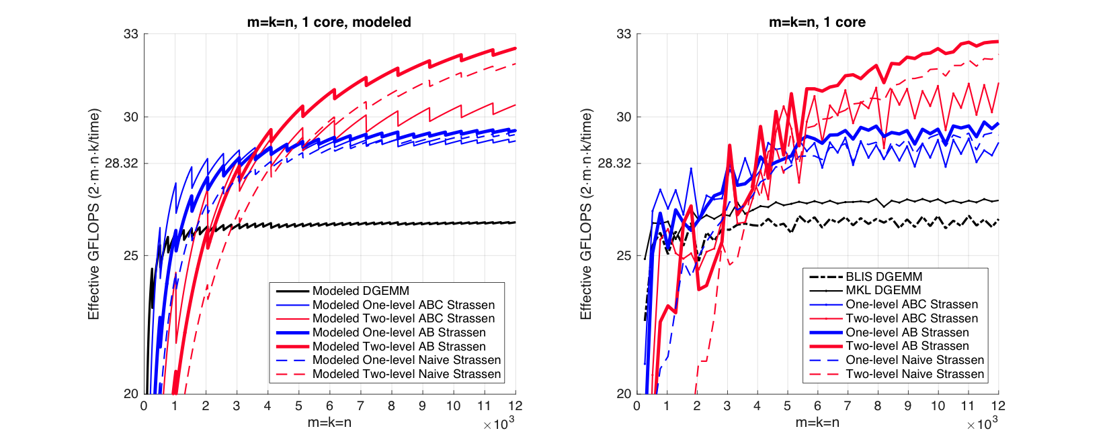
Observation (Square Matrices)
Modeled Performance
Actual Performance

Slide 58
Observation (Square Matrices)
Modeled Performance
Actual Performance
26.0%
13.1%
Theoretical Speedup over DGEMM
One-level Strassen (1+14.3% speedup)
8 multiplications → 7 multiplications;
Two-level Strassen (1+30.6% speedup)
64 multiplications → 49 multiplications;

Slide 59
Observation (Square Matrices)
Both one-level and two-level
For small square matrices, ABC Strassen outperforms AB Strassen
For larger square matrices, this trend reverses
Reason
ABC Strassen avoids storing M (M resides in the register)
ABC Strassen increases the number of times for updating submatrices of C

Slide 60
n_{C}
5th loop around micro-kernel
n_{C}
n_{C}
5th loop around micro-kernel
n_{C}
C_{j}
A
B
D_{j}
Y
W
n_{C}
n_{C}
n_{C}
n_{C}
+=
C_{j}
+=
X
V_{j}
4th loop around micro-kernel
4th loop around micro-kernel
C_{j}
A_{p}
k_{C}
B_{p}
D_{j}
Y_{p}
k_{C}
W_{p}
+=
C_{j}
+=
X_{p}
V_{p}
k_{C}
k_{C}
~
~
3rd loop around micro-kernel
Pack B_{p} → B_{p}
3rd loop around micro-kernel
Pack V_{p} + εW_{p} → B_{p}
C_{i}
A_{i}
~
D_{i}
m_{C}
Y_{i}
~
m_{C}
m_{C}
B_{p}
C_{i}
X_{i}
B_{p}
m_{C}
+=
+=
~
~
Pack A_{i}→ A_{i}
Pack X_{i} + δY_{i}→ A_{i}
n_{R}
2nd loop around micro-kernel
~
n_{R}
~
n_{R}
2nd loop around micro-kernel
~
n_{R}
~
A_{i}
B_{p}
A_{i}
B_{p}
C_{i}
m_{R}
D_{i}
m_{R}
+=
+=
k_{C}
C_{i}
k_{C}
n_{R}
1st loop around micro-kernel
n_{R}
1st loop around micro-kernel
m_{R}
+=
m_{R}
+=
Update C_{ij}
k_{C}
Update C_{ij} , D_{ij}
k_{C}
micro-kernel
micro-kernel
main memory
1
main memory
1
L3 cache
+=
L3 cache
+=
L2 cache
1
L2 cache
1
L1 cache
L1 cache
registers
registers

Slide 61
Observation (Rank-k Update)
What is Rank-k update?
n
k
n
m
m

Slide 62
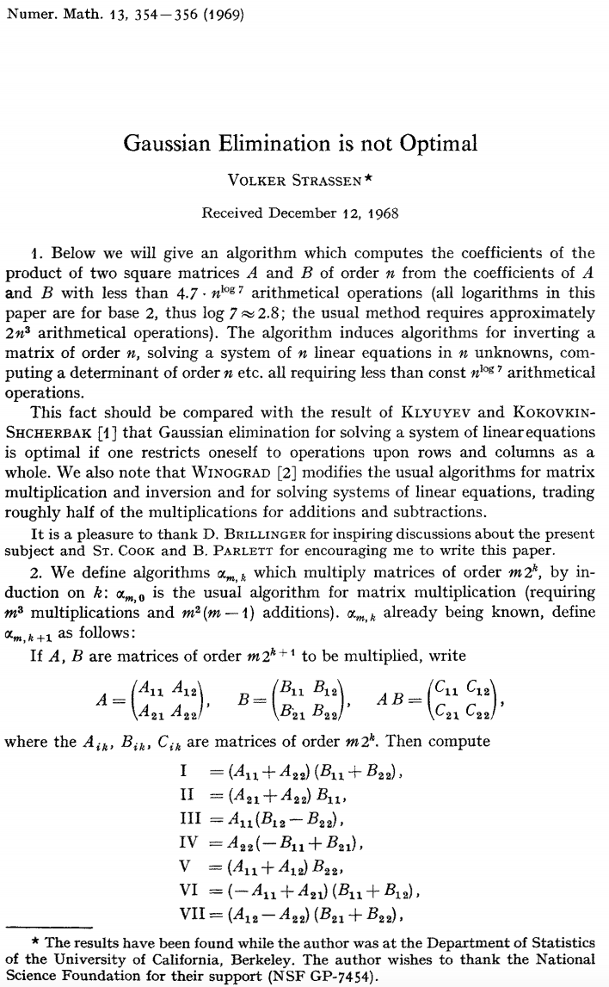
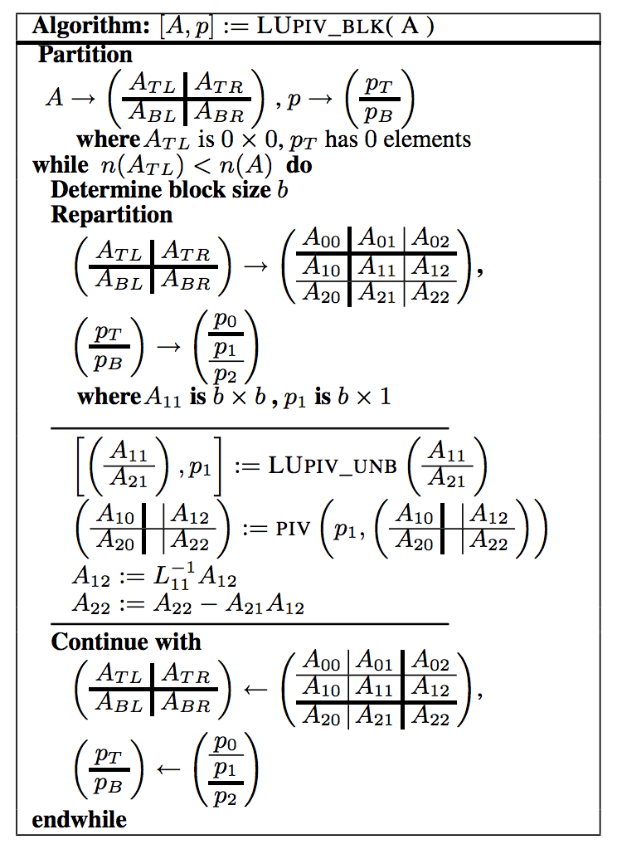
Observation (Rank-k Update)
Importance of Rank-k update
Blocked LU with partial pivoting (getrf)
A₁₂
A₂₁
A₂₂

Slide 63
Observation (Rank-k Update)
Importance of Rank-k update
A₁₂
+=
×
A₂₂
A₂₁

Slide 64
Observation (Rank-k Update)
Importance of Rank-k update
Blocked LU with partial pivoting (getrf)
A₁₂
A₂₁
A₂₂

Slide 65
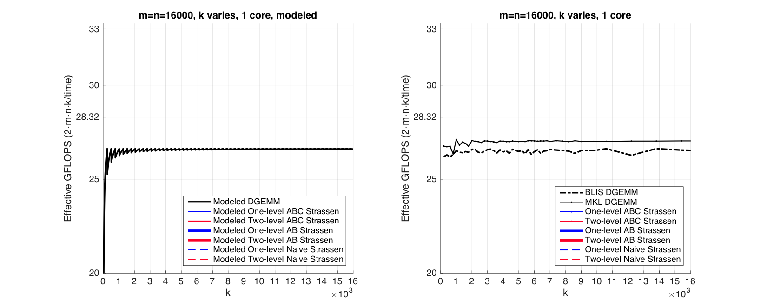
Observation (Rank-k Update)
Modeled Performance
Actual Performance

Slide 66
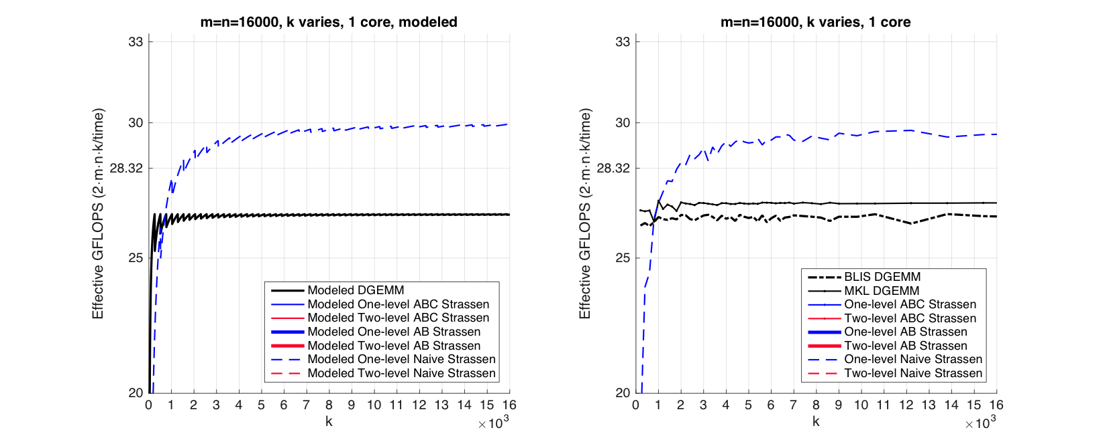
Observation (Rank-k Update)
Modeled Performance
Actual Performance

Slide 67
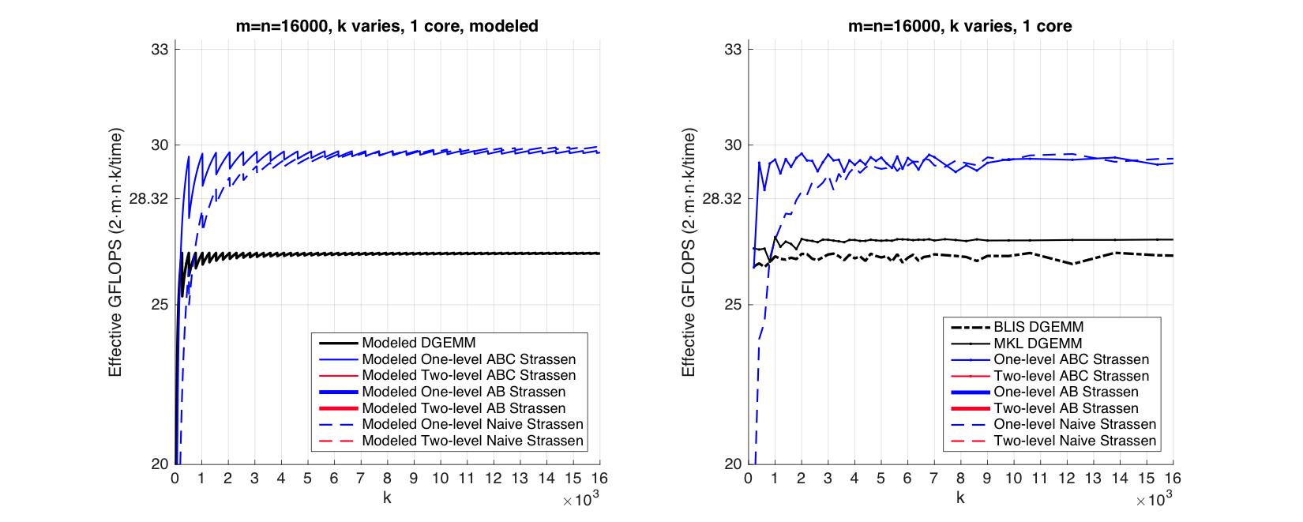
Observation (Rank-k Update)
Modeled Performance
Actual Performance

Slide 68
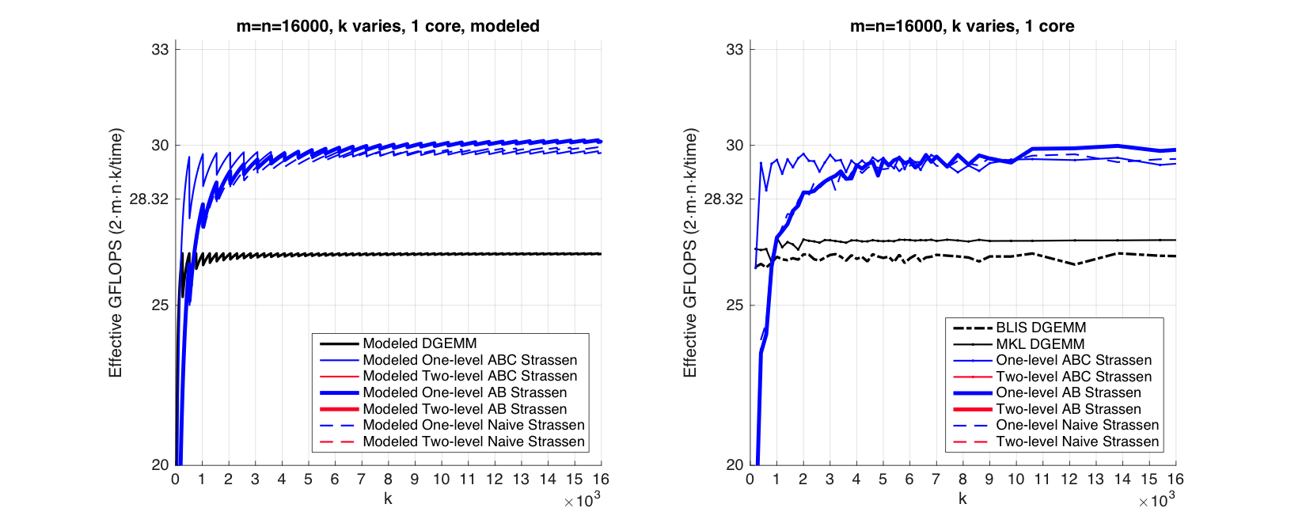
Observation (Rank-k Update)
Modeled Performance
Actual Performance

Slide 69
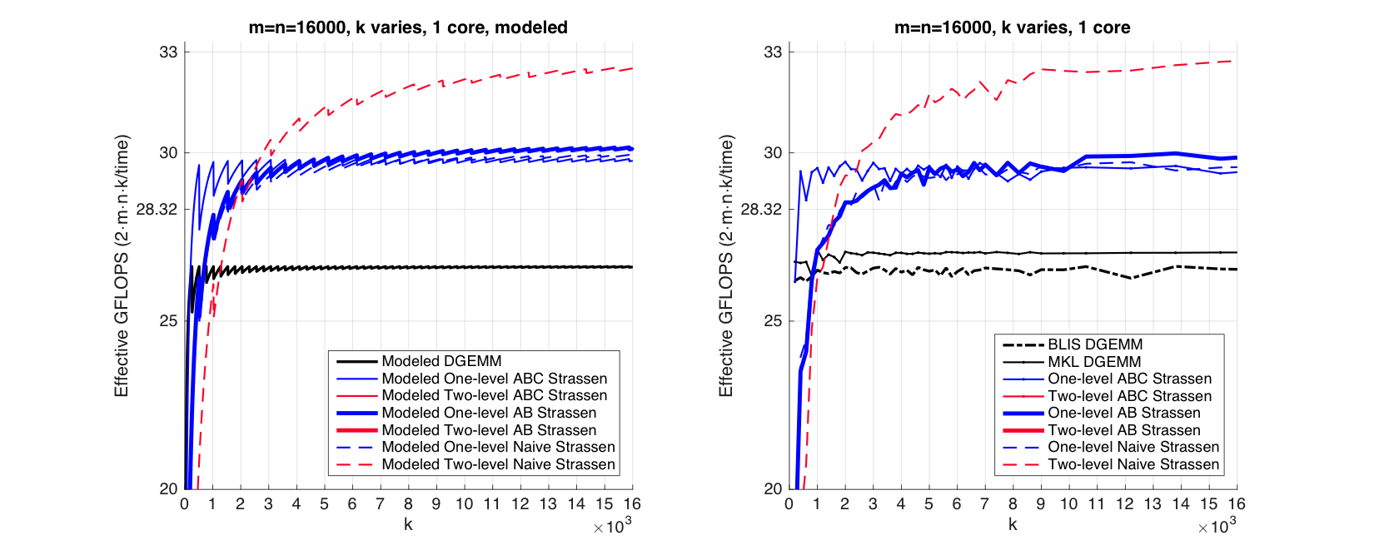
Observation (Rank-k Update)
Modeled Performance
Actual Performance

Slide 70
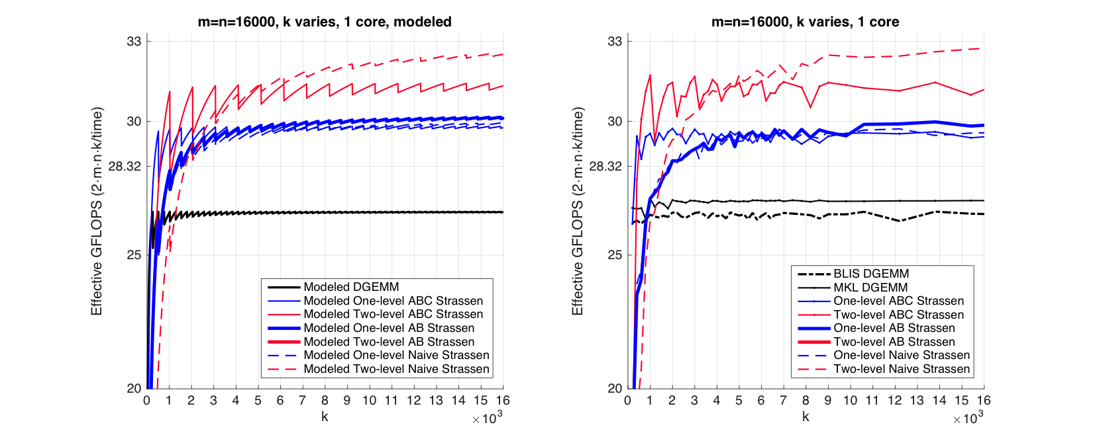
Observation (Rank-k Update)
Modeled Performance
Actual Performance

Slide 71
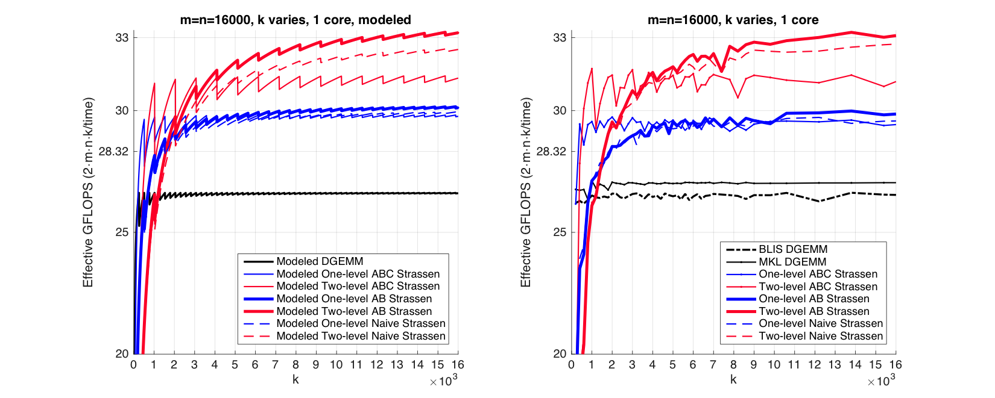
Observation (Rank-k Update)
Modeled Performance
Actual Performance

Slide 72
Observation (Rank-k Update)
For k equal to the appropriate multiple of k_{C}, ABC Strassen performs dramatically better than the other implementations
k = 2k_{C} for one-level Strassen
k = 4k_{C} for two-level Strassen
Reason:
ABC Strassen avoids forming the temporary matrice M explicitly in the memory (M resides in register), especially important when m, n >> k.

Slide 73
Bottom line: A different implementation may have its advantages depending on the problem size

Slide 74
Outline
Conventional Matrix-matrix multiplication
Strassen’s Algorithm Reloaded
High-performance Implementations
Theoretical Model and Analysis
Performance Experiments
Conclusion

Slide 75
Single Node Experiment

Slide 76
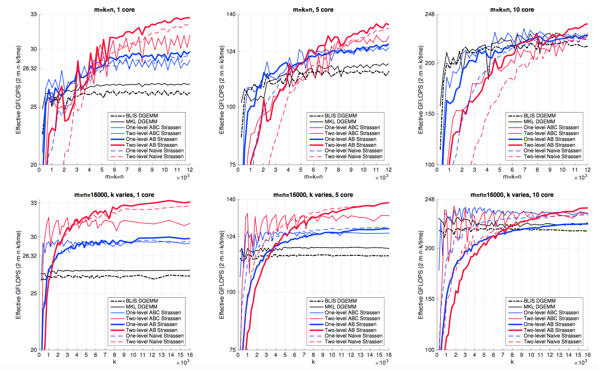
1 core
5 core
10 core
Square Matrices
Rank-k Update

Slide 77
Many-core Experiment

Slide 78
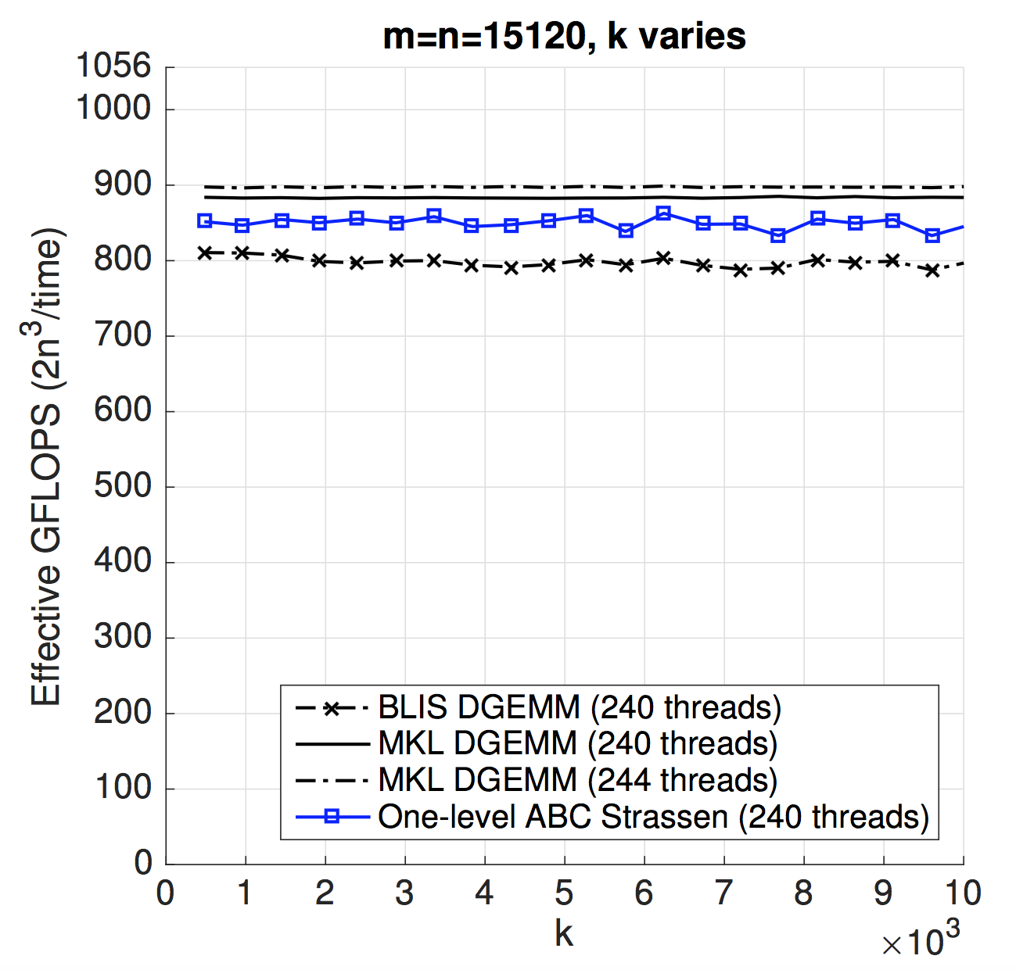
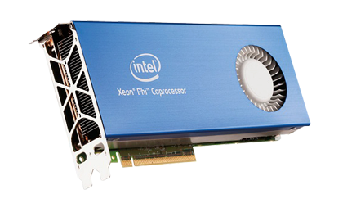
Intel® Xeon Phi™ coprocessor (KNC)

Slide 79
Distributed Memory Experiment

Slide 80
Accelerating SUMMA algorithm with Strassen
Rank-k update
B_{p}
+=
×
A_{p}
*Robert A. van de Geijn, and Jerrell Watts. "SUMMA: Scalable universal matrix multiplication algorithm." Concurrency-Practice and Experience 9, no. 4 (1997): 255-274.

Slide 81
Accelerating SUMMA algorithm with Strassen
Rank-k update
4k_{C}
B_{p}
+=
×
B
A_{p}
C
A
4k_{C}
*Robert A. van de Geijn, and Jerrell Watts. "SUMMA: Scalable universal matrix multiplication algorithm." Concurrency-Practice and Experience 9, no. 4 (1997): 255-274.

Slide 82
Effective GFLOPS/socket
Weak Scalability
An algorithm maintains efficiency as the number of processors varies and problem size/processor is fixed.
SUMMA is weakly scalable
MPI process number, or socket number
Problem size/socket

Slide 83
Problem size/socket is fixed to 16000
Efficiency

Slide 87
Outline
Conventional Matrix-matrix multiplication
Strassen’s Algorithm Reloaded
High-performance Implementations
Theoretical Model and Analysis
Performance Experiments
Conclusion

Slide 88
To achieve practical high performance
of Strassen’s algorithm…...
Conventional Implementations
Our Implementations
Matrix Size
Must be large
Matrix Shape
Must be square
No Additional
Workspace
Parallelism
Usually task parallelism
Can be data parallelism

Slide 89
Summary
Present novel insights into the implementations of Strassen
Develop a family of Strassen algorithms
Derive a performance model that predicts the run time of the various implementations
Demonstrate performance benefits for single-core, multi-core, many-core, and distributed memory implementations

Slide 90
Thank you!
Jianyu Huang
http://www.cs.utexas.edu/~jianyu
Tyler Smith
http://www.cs.utexas.edu/~tms
Get BLIS:
http://github.com/flame/blis

